Slide 1
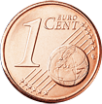
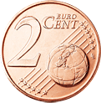
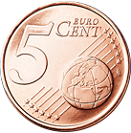
Rounding Money
© Seomra Ranga 2015 www.seomraranga.com

Slide 2
When?
Rounding will take place from Wednesday October 28th, 2015 (Rounding Rollout Day)
© Seomra Ranga 2015 www.seomraranga.com

Slide 3
Why?
1c and 2c coins are costly to produce
People don’t like using them and keep them at home in jars!
This means there are not enough of these coins in circulation
© Seomra Ranga 2015 www.seomraranga.com

Slide 4
Why?
A 1c coin costs 1.65c to produce.
© Seomra Ranga 2015 www.seomraranga.com

Slide 5
Why?
A 2c coin costs 1.94c to produce.
© Seomra Ranga 2015 www.seomraranga.com

Slide 6
What?
The total bill in a shop will be either rounded up or down to the nearest 5c
© Seomra Ranga 2015 www.seomraranga.com

Slide 7
What?
Bills ending in 1c, 2c, 6c, 7c will be rounded down
Bills ending in 3c, 4c, 8c, 9c will be rounded up
© Seomra Ranga 2015 www.seomraranga.com

Slide 8
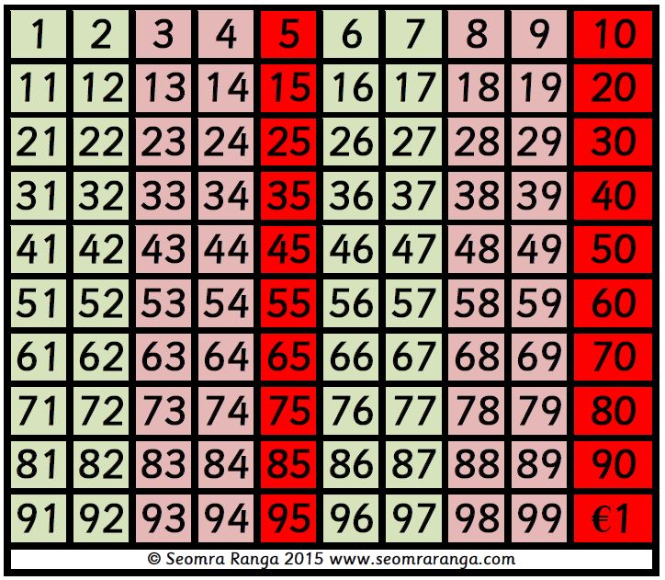
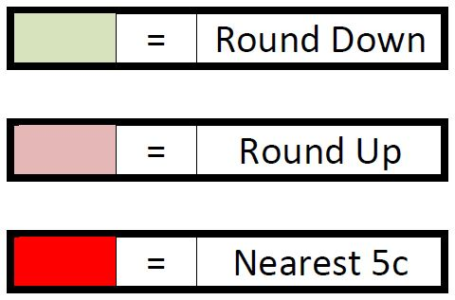
What?
© Seomra Ranga 2015 www.seomraranga.com

Slide 9
Examples
€2.31 rounds to €2.30
€1.42 rounds to €1.40
€3.53 rounds to €3.55
€7.74 rounds to €7.75
© Seomra Ranga 2015 www.seomraranga.com

Slide 10
Examples
€5.66 rounds to €5.65
€7.87 rounds to €7.85
€8.58 rounds to €8.60
€9.29 rounds to €9.30
© Seomra Ranga 2015 www.seomraranga.com

Slide 11
Conditions
Rounding will be voluntary, for both customer and retailer
1c and 2c coins will remain legal tender
Rounding will only apply to cash payments
Rounding will not apply to credit/debit card transactions, cheques or electronic payments
Rounding will only apply to the total bill, not to individual items
Internet transactions will not be affected
© Seomra Ranga 2015 www.seomraranga.com

Slide 12
Facts
A rounding trial was held in Wexford in 2013
Since the introduction of the Euro (€) in 2002, €37 million worth of 1c & 2c coins has been issued in Ireland
Six other EU countries have already introduced Rounding: Belgium, Denmark, Finland, Hungary, Netherlands, Sweden
© Seomra Ranga 2015 www.seomraranga.com

Slide 13
Fact
1,384,491,236 1c coins have been issued in Ireland since 2002
© Seomra Ranga 2015 www.seomraranga.com

Slide 14
Fact
1,096,853,216 2c coins have been issued in Ireland since 2002
© Seomra Ranga 2015 www.seomraranga.com

