Slide 1
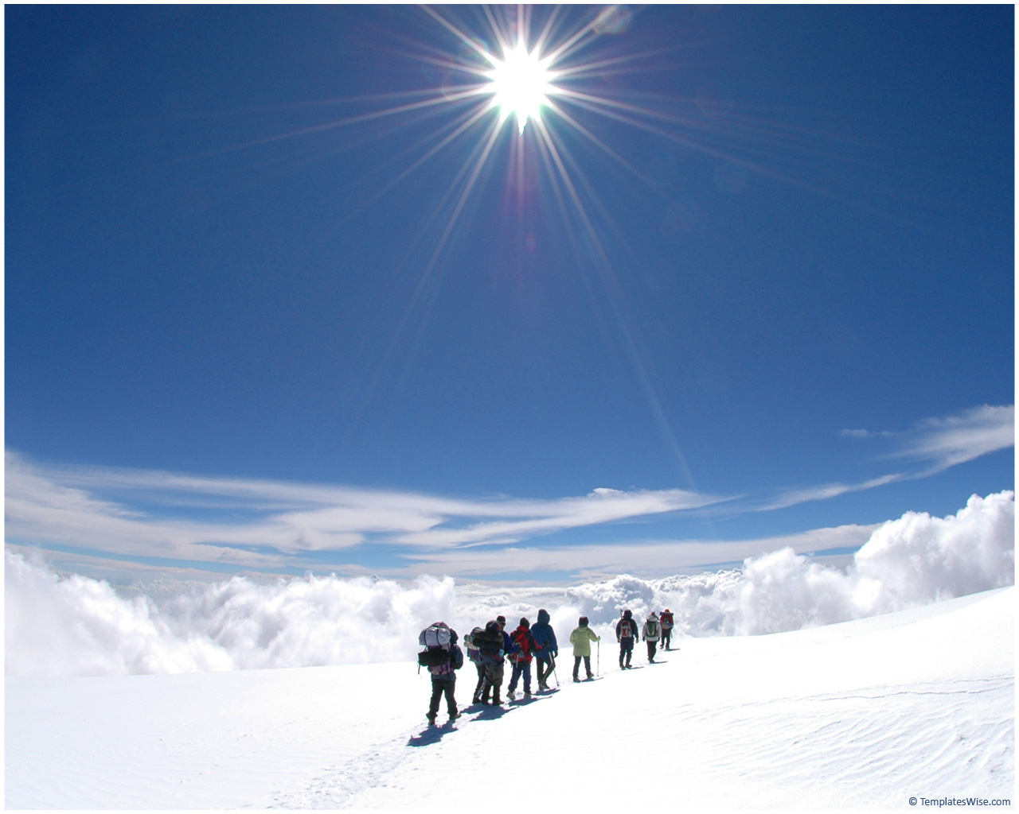
POLAR REGIONS TABLE QUIZ
© Seomra Ranga 2016 www.seomraranga.com

Slide 2
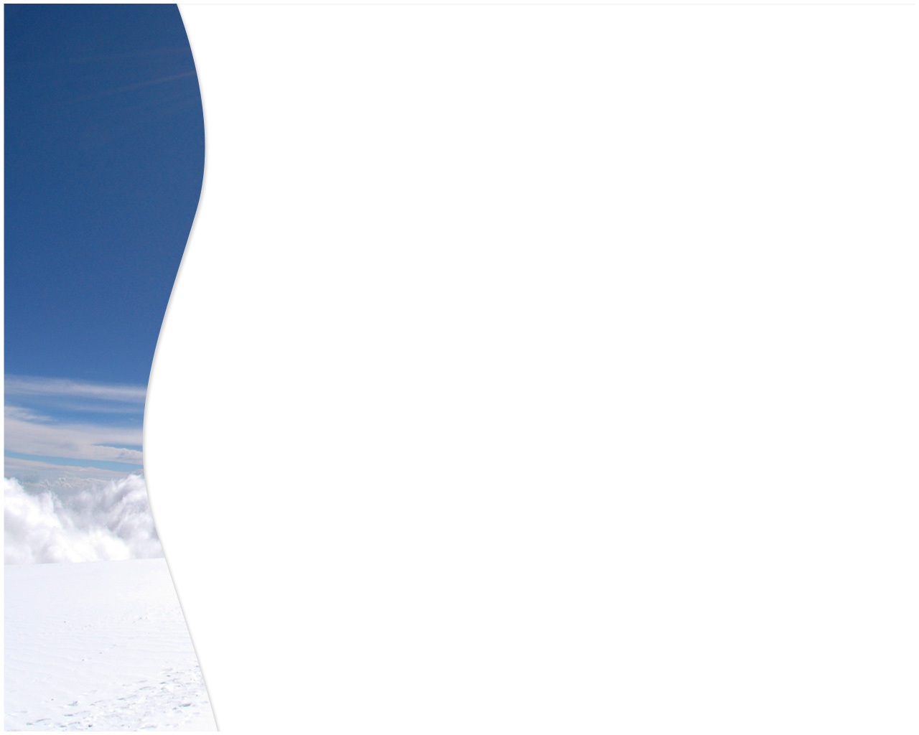
Before You Start
Make sure you have written your table/group number on every answer sheet
Write the number of each round 1-6 on every answer sheet
Try not to shout out answers
Don’t worry about spellings – do your best
Good luck and enjoy the quiz
© Seomra Ranga 2016 www.seomraranga.com

Slide 3
ROUND 1
© Seomra Ranga 2016 www.seomraranga.com

Slide 4
Round 1
Question 1
What is a baby seal called?
© Seomra Ranga 2016 www.seomraranga.com

Slide 5
Round 1
Question 2
True or false: the fur of an Arctic Fox is red?
© Seomra Ranga 2016 www.seomraranga.com

Slide 6
Round 1
Question 3
Unscramble the letters to make a bird found in the Arctic:
RENT
© Seomra Ranga 2016 www.seomraranga.com

Slide 7
Round 1
Question 4
Who guards the penguin’s egg and keeps it warm – the male or the female penguin?
© Seomra Ranga 2016 www.seomraranga.com

Slide 8
Round 1
Question 5
What is the Inuit word for ‘home’?
© Seomra Ranga 2016 www.seomraranga.com

Slide 9
Round 1
Question 6
True or False: the North Pole is in Antarctica?
© Seomra Ranga 2016 www.seomraranga.com

Slide 10
Polar Bear Joke #1
What do polar bears eat for lunch?
Ice berg-ers!
© Seomra Ranga 2016 www.seomraranga.com

Slide 11
ROUND 2
© Seomra Ranga 2016 www.seomraranga.com

Slide 12
Round 2
Question 1
What is another name for a reindeer?
© Seomra Ranga 2016 www.seomraranga.com

Slide 13
Round 2
Question 2
Antarctica is:
Sea surrounded by land
Land surrounded by sea
© Seomra Ranga 2016 www.seomraranga.com

Slide 14
Round 2
Question 3
True or False: Killer whales live in the Arctic?
© Seomra Ranga 2016 www.seomraranga.com

Slide 15
Round 2
Question 4
What is the fat under the skin of a seal or walrus called?
© Seomra Ranga 2016 www.seomraranga.com

Slide 16
Round 2
Question 5
What colour is a polar bear’s skin? (Hint: not its fur!)
© Seomra Ranga 2016 www.seomraranga.com

Slide 17
Round 2
Question 6
Which is the largest type of penguin?
© Seomra Ranga 2016 www.seomraranga.com

Slide 18
Polar Bear Joke #2
What’s a balanced diet for a polar bear?
A seal in each paw!
© Seomra Ranga 2016 www.seomraranga.com

Slide 19
ROUND 1 ANSWERS
© Seomra Ranga 2016 www.seomraranga.com

Slide 20
Round 1 Answers
Question 1
What is a baby seal called?
Cub
© Seomra Ranga 2016 www.seomraranga.com

Slide 21
Round 1 Answers
Question 2
True or false: the fur of an Arctic Fox is red?
False
© Seomra Ranga 2016 www.seomraranga.com

Slide 22
Round 1 Answers
Question 3
Unscramble the letters to make a bird found in the Arctic:
RENT
Tern
© Seomra Ranga 2016 www.seomraranga.com

Slide 23
Round 1 Answers
Question 4
Who guards the penguin’s egg and keeps it warm – the male or the female penguin?
Male
© Seomra Ranga 2016 www.seomraranga.com

Slide 24
Round 1 Answers
Question 5
What is the Inuit word for ‘home’?
Igloo
© Seomra Ranga 2016 www.seomraranga.com

Slide 25
Round 1 Answers
Question 6
True or False: the North Pole is in Antarctica?
False
© Seomra Ranga 2016 www.seomraranga.com

Slide 26
Polar Bear Joke #3
What did the polar bear eat after the dentist fixed its tooth?
The dentist!
© Seomra Ranga 2016 www.seomraranga.com

Slide 27
ROUND 3
© Seomra Ranga 2016 www.seomraranga.com

Slide 28
Round 3
Question 1
How many eggs does a penguin lay?
© Seomra Ranga 2016 www.seomraranga.com

Slide 29
Round 3
Question 2
What type of dog drives an Inuit’s Sled?
© Seomra Ranga 2016 www.seomraranga.com

Slide 30
Round 3
Question 3
Which of these is an island off the coast of Antarctica:
Tiger Island
Monkey Island
Elephant Island
© Seomra Ranga 2016 www.seomraranga.com

Slide 31
Round 3
Question 4
Who wrote the book ‘Can’t You Sleep, Little Bear’?
© Seomra Ranga 2016 www.seomraranga.com

Slide 32
Round 3
Question 5
What animal is top of the Arctic food chain?
© Seomra Ranga 2016 www.seomraranga.com

Slide 33
Round 3
Question 6
Which is colder, the Arctic or the Antarctic?
© Seomra Ranga 2016 www.seomraranga.com

Slide 34
Polar Bear Joke #4
What do polar bears like to eat?
Brrrrrr-itos!
© Seomra Ranga 2016 www.seomraranga.com

Slide 35
ROUND 2 ANSWERS
© Seomra Ranga 2016 www.seomraranga.com

Slide 36
Round 2 Answers
Question 1
What is another name for a reindeer?
Caribou
© Seomra Ranga 2016 www.seomraranga.com

Slide 37
Round 2 Answers
Question 2
Antarctica is:
Sea surrounded by land
Land surrounded by sea
Land surrounded by sea
© Seomra Ranga 2016 www.seomraranga.com

Slide 38
Round 2 Answers
Question 3
True or False: Killer whales live in the Arctic?
True
© Seomra Ranga 2016 www.seomraranga.com

Slide 39
Round 2 Answers
Question 4
What is the fat under the skin of a seal or walrus called?
Blubber
© Seomra Ranga 2016 www.seomraranga.com

Slide 40
Round 2 Answers
Question 5
What colour is a polar bear’s skin? (Hint: not its fur!)
Black
© Seomra Ranga 2016 www.seomraranga.com

Slide 41
Round 2 Answers
Question 6
Which is the largest type of penguin?
Emperor
© Seomra Ranga 2016 www.seomraranga.com

Slide 42
Polar Bear Joke #5
Why don’t polar bears like fast food?
Because they can’t catch it!
© Seomra Ranga 2016 www.seomraranga.com

Slide 43
ROUND 4
© Seomra Ranga 2016 www.seomraranga.com

Slide 44
Round 4
Question 1
True or false: the South Pole is in Antarctica?
© Seomra Ranga 2016 www.seomraranga.com

Slide 45
Round 4
Question 2
What colour eyes has a husky dog?
© Seomra Ranga 2016 www.seomraranga.com

Slide 46
Round 4
Question 3
Put these animals into alphabetical order:
seal, husky, penguin, walrus, caribou
© Seomra Ranga 2016 www.seomraranga.com

Slide 47
Round 4
Question 4
What animals hunt together in a pack?
© Seomra Ranga 2016 www.seomraranga.com

Slide 48
Round 4
Question 5
How many cubs does a polar bear usually have?
© Seomra Ranga 2016 www.seomraranga.com

Slide 49
Round 4
Question 6
What kind of seal has spots on its body?
© Seomra Ranga 2016 www.seomraranga.com

Slide 50
Polar Bear Joke #6
How does a polar bear stop a DVD?
By pressing the ‘paws’ button!
© Seomra Ranga 2016 www.seomraranga.com

Slide 51
ROUND 3 ANSWERS
© Seomra Ranga 2016 www.seomraranga.com

Slide 52
Round 3 Answers
Question 1
How many eggs does a penguin lay?
One
© Seomra Ranga 2016 www.seomraranga.com

Slide 53
Round 3 Answers
Question 2
What type of dog drives an Inuit’s Sled?
Husky
© Seomra Ranga 2016 www.seomraranga.com

Slide 54
Round 3 Answers
Question 3
Which of these is an island off the coast of Antarctica:
Tiger Island
Monkey Island
Elephant Island
Elephant Island
© Seomra Ranga 2016 www.seomraranga.com

Slide 55
Round 3 Answers
Question 4
Who wrote the book ‘Can’t You Sleep, Little Bear’?
Martin Waddell
© Seomra Ranga 2016 www.seomraranga.com

Slide 56
Round 3 Answers
Question 5
What animal is top of the Arctic food chain?
Polar Bear
© Seomra Ranga 2016 www.seomraranga.com

Slide 57
Round 3 Answers
Question 6
Which is colder, the Arctic or Antarctica?
Antarctica
© Seomra Ranga 2016 www.seomraranga.com

Slide 58
Polar Bear Joke #7
What do you call a dream in which polar bears are chasing you?
A bite-mare!
© Seomra Ranga 2016 www.seomraranga.com

Slide 59
ROUND 5
© Seomra Ranga 2016 www.seomraranga.com

Slide 60
Round 5
Question 1
What are igloos made of?
© Seomra Ranga 2016 www.seomraranga.com

Slide 61
Round 5
Question 2
Is a polar bear a ‘herbivore’ or a ‘carnivore’?
© Seomra Ranga 2016 www.seomraranga.com

Slide 62
Round 5
Question 3
What is the name given to the colourful lights seen in the sky at the North Pole?
© Seomra Ranga 2016 www.seomraranga.com

Slide 63
Round 5
Question 4
Unscramble the letters to get the name of an Arctic animal:
LURWAS
© Seomra Ranga 2016 www.seomraranga.com

Slide 64
Round 5
Question 5
What is a baby Arctic Fox called?
© Seomra Ranga 2016 www.seomraranga.com

Slide 65
Round 5
Question 6
What is a large group of penguins called?
© Seomra Ranga 2016 www.seomraranga.com

Slide 66
Polar Bear Joke #8
What did the polar bear say when it saw a seal on a bike?
Meals on Wheels!
© Seomra Ranga 2016 www.seomraranga.com

Slide 67
ROUND 4 ANSWERS
© Seomra Ranga 2016 www.seomraranga.com

Slide 68
Round 4 Answers
Question 1
True or false: the South Pole is in Antarctica?
True
© Seomra Ranga 2016 www.seomraranga.com

Slide 69
Round 4 Answers
Question 2
What colour eyes has a husky dog?
Blue
© Seomra Ranga 2016 www.seomraranga.com

Slide 70
Round 4 Answers
Question 3
Put these animals into alphabetical order:
seal, husky, penguin, walrus, caribou
Caribou, Husky, Penguin, Seal, Walrus
© Seomra Ranga 2016 www.seomraranga.com

Slide 71
Round 4 Answers
Question 4
What animals hunt together in a pack?
Wolves
© Seomra Ranga 2016 www.seomraranga.com

Slide 72
Round 4 Answers
Question 5
How many cubs does a polar bear usually have?
Two
© Seomra Ranga 2016 www.seomraranga.com

Slide 73
Round 4 Answers
Question 6
What kind of seal has spots on its body?
Leopard Seal
© Seomra Ranga 2016 www.seomraranga.com

Slide 74
Polar Bear Joke #9
What do you call a big mean polar bear heading your way?
Don’t call it anything, just run!
© Seomra Ranga 2016 www.seomraranga.com

Slide 75
ROUND 6
© Seomra Ranga 2016 www.seomraranga.com

Slide 76
Round 6
Question 1
True or false: Penguins can fly?
© Seomra Ranga 2016 www.seomraranga.com

Slide 77
Round 6
Question 2
What was the name of the famous ship that hit an iceberg and sank on its first journey?
© Seomra Ranga 2016 www.seomraranga.com

Slide 78
Round 6
Question 3
What is an Inuit’s coat called?
© Seomra Ranga 2016 www.seomraranga.com

Slide 79
Round 6
Question 4
True or False: female leopard seals are larger than males?
© Seomra Ranga 2016 www.seomraranga.com

Slide 80
Round 6
Question 5
What kind of food do Inuits mostly eat?
© Seomra Ranga 2016 www.seomraranga.com

Slide 81
Round 6
Question 6
‘Mumble’ is the main character in the ‘Happy Feet’ movie. What kind of animal is he?
© Seomra Ranga 2016 www.seomraranga.com

Slide 82
Polar Bear Joke #10
Why would polar bears be cheap to keep as pets?
They live on ice!
© Seomra Ranga 2016 www.seomraranga.com

Slide 83
ROUND 5 ANSWERS
© Seomra Ranga 2016 www.seomraranga.com

Slide 84
Round 5 Answers
Question 1
What are igloos made of?
Snow
© Seomra Ranga 2016 www.seomraranga.com

Slide 85
Round 5 Answers
Question 2
Is a polar bear a ‘herbivore’ or a ‘carnivore’?
Carnivore
© Seomra Ranga 2016 www.seomraranga.com

Slide 86
Round 5 Answers
Question 3
What is the name given to the colourful lights seen in the sky at the North Pole?
Northern Lights
© Seomra Ranga 2016 www.seomraranga.com

Slide 87
Round 5 Answers
Question 4
Unscramble the letters to get the name of an Arctic animal:
LURWAS
Walrus
© Seomra Ranga 2016 www.seomraranga.com

Slide 88
Round 5 Answers
Question 5
What is a baby Arctic Fox called?
Kit/Pup
© Seomra Ranga 2016 www.seomraranga.com

Slide 89
Round 5 Answers
Question 6
What is a large group of penguins called?
Colony
© Seomra Ranga 2016 www.seomraranga.com

Slide 90
Polar Bear Joke #11
Where do you find polar bears?
Wherever you lost them!
© Seomra Ranga 2016 www.seomraranga.com

Slide 91
ROUND 6 ANSWERS
© Seomra Ranga 2016 www.seomraranga.com

Slide 92
Round 6 Answers
Question 1
True or false: Penguins can fly?
False
© Seomra Ranga 2016 www.seomraranga.com

Slide 93
Round 6 Answers
Question 2
What was the name of the famous ship that hit an iceberg and sank on its first journey?
Titanic
© Seomra Ranga 2016 www.seomraranga.com

Slide 94
Round 6 Answers
Question 3
What is an Inuit’s coat called?
Parka
© Seomra Ranga 2016 www.seomraranga.com

Slide 95
Round 6 Answers
Question 4
True or False: female leopard seals are larger than males?
True
© Seomra Ranga 2016 www.seomraranga.com

Slide 96
Round 6 Answers
Question 5
What kind of food do Inuits mostly eat?
Meat/Fish
© Seomra Ranga 2016 www.seomraranga.com

Slide 97
Round 6 Answers
Question 6
‘Mumble’ is the main character in the ‘Happy Feet’ movie. What kind of animal is he?
Penguin
© Seomra Ranga 2016 www.seomraranga.com

Slide 98
Polar Bear Joke #12
What do you get when you cross a polar bear with a rose?
I don’t know but I wouldn’t try to smell it!
© Seomra Ranga 2016 www.seomraranga.com

Slide 99
TIE-BREAK ROUND
© Seomra Ranga 2016 www.seomraranga.com

Slide 100
Tie-Break Round
Question 1
What does a walrus use to climb up on the ice?
© Seomra Ranga 2016 www.seomraranga.com

Slide 101
Tie-Break Round
Question 2
What animal has the warmest fur on the planet:
Arctic Fox
Polar Bear
Seal
© Seomra Ranga 2016 www.seomraranga.com

Slide 102
Tie-Break Round
Question 3
True or False: Polar Bears live in Antarctica?
© Seomra Ranga 2016 www.seomraranga.com

Slide 103
Tie-Break Round
Question 4
Antarctica has the largest:
Desert
Mountains
Volcano
© Seomra Ranga 2016 www.seomraranga.com

Slide 104
Tie-Break Round
Question 5
What whale is sometimes called a ‘unicorn whale’?
© Seomra Ranga 2016 www.seomraranga.com

Slide 105
Tie-Break Round
Question 6
What word means a journey to Antarctica:
exhibition
expedition
exhaustion
© Seomra Ranga 2016 www.seomraranga.com

Slide 106
Polar Bear Joke #13
What do polar bears like to eat in the cold?
Brrrrrr-gers!
© Seomra Ranga 2016 www.seomraranga.com

Slide 107
TIE-BREAK ROUND ANSWERS
© Seomra Ranga 2016 www.seomraranga.com

Slide 108
Tie-Break Answers
Question 1
What does a walrus use to climb up on the ice?
Tusks
© Seomra Ranga 2016 www.seomraranga.com

Slide 109
Tie-Break Answers
Question 2
What animal has the warmest fur on the planet:
Arctic Fox
Polar Bear
Seal
Arctic Fox
© Seomra Ranga 2016 www.seomraranga.com

Slide 110
Tie-Break Answers
Question 3
True or False: Polar Bears live in Antarctica?
False
© Seomra Ranga 2016 www.seomraranga.com

Slide 111
Tie-Break Answers
Question 4
Antarctica has the largest:
Desert
Mountains
Volcano
Desert
© Seomra Ranga 2016 www.seomraranga.com

Slide 112
Tie-Break Answers
Question 5
What whale is sometimes called a ‘unicorn whale’?
Narwhal
© Seomra Ranga 2016 www.seomraranga.com

Slide 113
Tie-Break Answers
Question 6
What word means a journey to Antarctica:
exhibition
expedition
exhaustion
Expedition
© Seomra Ranga 2016 www.seomraranga.com

Slide 114
Polar Bear Joke #14
What do you call a polar bear on thin ice?
An ice breaker!
© Seomra Ranga 2016 www.seomraranga.com

Slide 115
HOPE YOU ALL ENJOYED THE POLAR REGIONS TABLE QUIZ
© Seomra Ranga 2016 www.seomraranga.com

