Slide 1
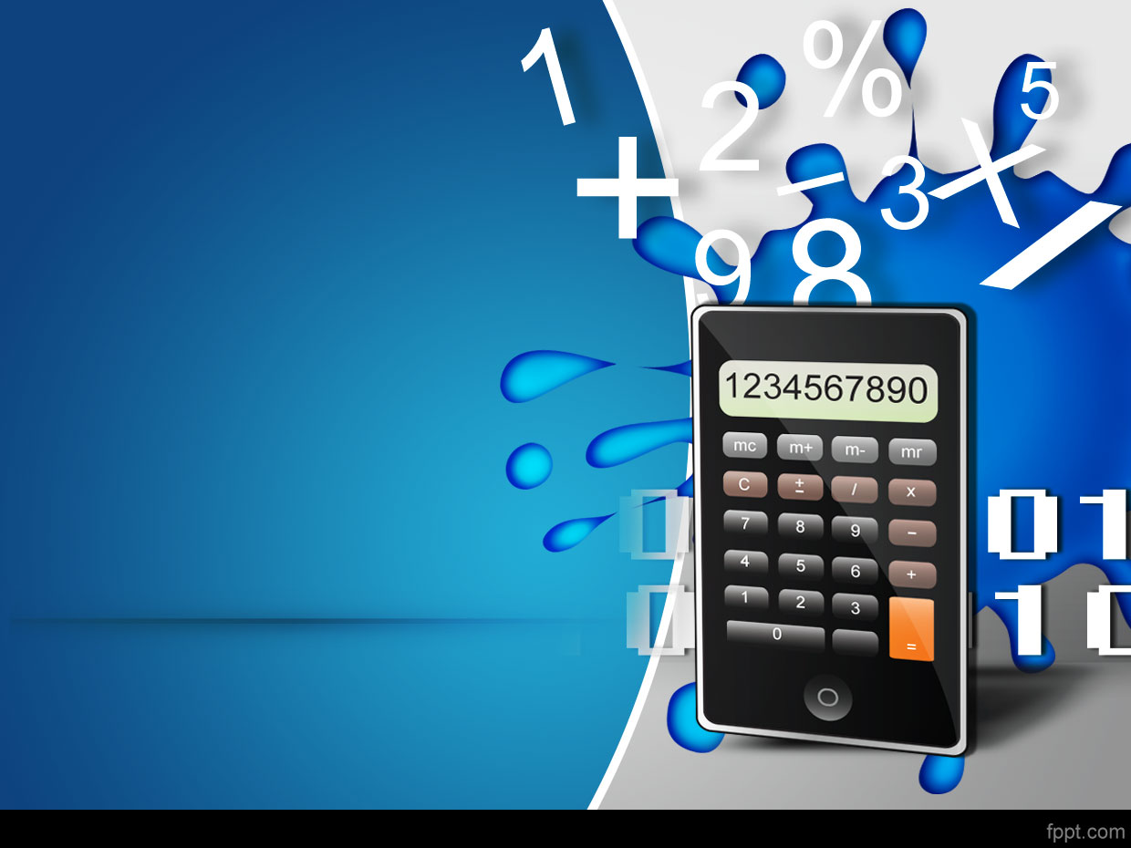

Maths Week 2017
Junior Table Quiz
© Seomra Ranga 2017 www.seomraranga.com

Slide 2
Before You Start
Make sure you have written your table/team number/letter on every answer sheet
Write the number of each round 1-8 on every answer sheet
Try not to shout out answers
Check with your team mates and agree an answer before you write it down
© Seomra Ranga 2017 www.seomraranga.com

Slide 3
Before You Start
Don’t worry about spellings – just do your best
If you’re not sure of the answer, make your best possible guess
It might be a good idea to have a piece of paper to do some rough calculations for some questions
Good luck and enjoy the quiz
© Seomra Ranga 2017 www.seomraranga.com

Slide 4
ROUND 1
© Seomra Ranga 2017 www.seomraranga.com

Slide 5
Round 1
Question 1
What is the missing number: 2, 4, 6, ___, 10, 12
© Seomra Ranga 2017 www.seomraranga.com

Slide 6
Round 1
Question 2
Is 11 an odd or an even number?
© Seomra Ranga 2017 www.seomraranga.com

Slide 7
Round 1
Question 3
Add 4, 8, 3 and 2
© Seomra Ranga 2017 www.seomraranga.com

Slide 8
Round 1
Question 4
How many cent in €2?
© Seomra Ranga 2017 www.seomraranga.com

Slide 9
Round 1
Question 5
My tens number is 8. My units number is 1. My hundreds number is 3. What number am I?
© Seomra Ranga 2017 www.seomraranga.com

Slide 10
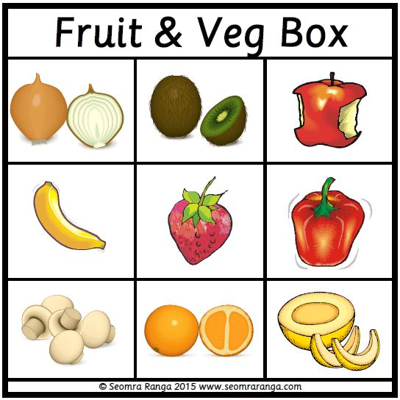
Round 1
Question 6
Starting with the oranges, move two squares up and one square to the right. What fruit is this?
© Seomra Ranga 2017 www.seomraranga.com

Slide 11
Maths Joke #1
Why did the girl wear glasses during maths class?
Because it improves di-vision!
© Seomra Ranga 2017 www.seomraranga.com

Slide 12
ROUND 2
© Seomra Ranga 2017 www.seomraranga.com

Slide 13
Round 2
Question 1
Name this shape:
© Seomra Ranga 2017 www.seomraranga.com

Slide 14
Round 2
Question 2
What day comes two days after Thursday?
© Seomra Ranga 2017 www.seomraranga.com

Slide 15
Round 2
Question 3
How many eggs in a dozen?
© Seomra Ranga 2017 www.seomraranga.com

Slide 16
Round 2
Question 4
What number is supposed to be unlucky: 7, 11, 13 or 17?
© Seomra Ranga 2017 www.seomraranga.com

Slide 17
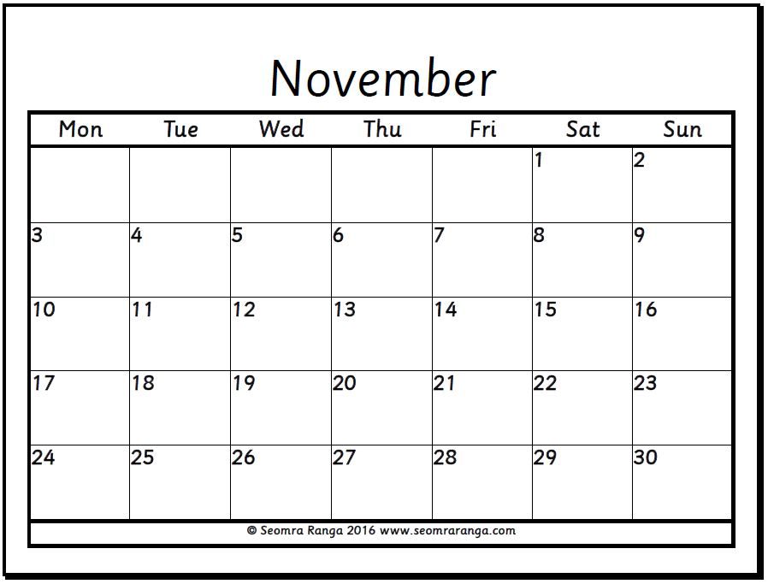
Round 2
Question 5
How many Saturdays in November?
© Seomra Ranga 2017 www.seomraranga.com

Slide 18
Round 2
Question 6
If a bag of sweets cost 50c, how many bags can I buy for €2?
© Seomra Ranga 2017 www.seomraranga.com

Slide 19
Maths Joke #2
Why did the maths book look so sad?
It had so many problems!
© Seomra Ranga 2017 www.seomraranga.com

Slide 20
ROUND 1 ANSWERS
© Seomra Ranga 2017 www.seomraranga.com

Slide 21
Round 1 Answers
Question 1
What is the missing number: 2, 4, 6, ___, 10, 12
8
© Seomra Ranga 2017 www.seomraranga.com

Slide 22
Round 1 Answers
Question 2
Is 11 an odd or an even number?
Odd
© Seomra Ranga 2017 www.seomraranga.com

Slide 23
Round 1 Answers
Question 3
Add 4, 8, 3 and 2
17
© Seomra Ranga 2017 www.seomraranga.com

Slide 24
Round 1 Answers
Question 4
How many cent in €2?
200
© Seomra Ranga 2017 www.seomraranga.com

Slide 25
Round 1 Answers
Question 5
My tens number is 8. My units number is 1. My hundreds number is 3. What number am I?
381
© Seomra Ranga 2017 www.seomraranga.com

Slide 26
Round 1 Answers
Question 6
Starting with the oranges, move two squares up and one square to the right. What fruit is this?
Apple
© Seomra Ranga 2017 www.seomraranga.com

Slide 27
Maths Joke #3
What did the zero say to the 8?
Nice belt!
© Seomra Ranga 2017 www.seomraranga.com

Slide 28
ROUND 3
© Seomra Ranga 2017 www.seomraranga.com

Slide 29
Round 3
Question 1
Write the number thirty eight.
© Seomra Ranga 2017 www.seomraranga.com

Slide 30
Round 3
Question 2
How many hours in a day?
© Seomra Ranga 2017 www.seomraranga.com

Slide 31
Round 3
Question 3
Which is the longest: (a) season (b) day (c) month (d) week?
© Seomra Ranga 2017 www.seomraranga.com

Slide 32
Round 3
Question 4
True or False:
2 + 4 + 3 = 3 + 2 + 4
© Seomra Ranga 2017 www.seomraranga.com

Slide 33
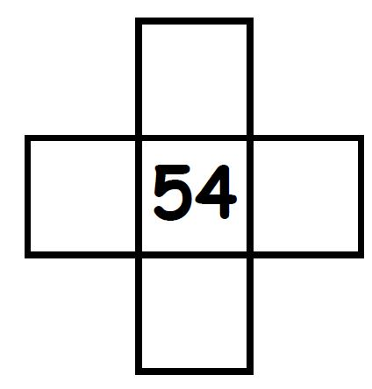
Round 3
Question 5
This is cut out from a 100 Square. What number goes in the bottom box?
© Seomra Ranga 2017 www.seomraranga.com

Slide 34
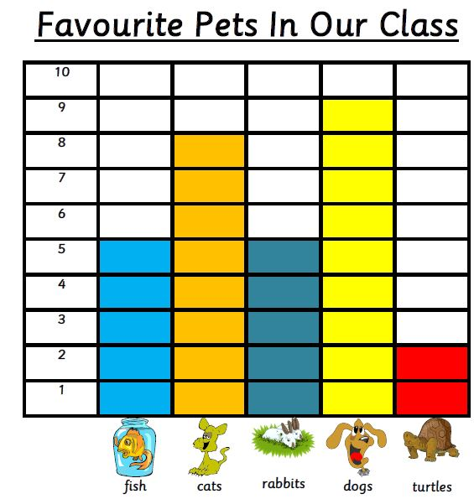
Round 3
Question 6
Which is the most favourite pet in this class?
© Seomra Ranga 2017 www.seomraranga.com

Slide 35
Maths Joke #4
Why did the boy eat his maths homework?
Because the teacher told him it was a piece of cake!
© Seomra Ranga 2017 www.seomraranga.com

Slide 36
ROUND 2 ANSWERS
© Seomra Ranga 2017 www.seomraranga.com

Slide 37
Round 2 Answers
Question 1
Name this shape:
Rectangle
© Seomra Ranga 2017 www.seomraranga.com

Slide 38
Round 2 Answers
Question 2
What day comes two days after Thursday?
Saturday
© Seomra Ranga 2017 www.seomraranga.com

Slide 39
Round 2 Answers
Question 3
How many eggs in a dozen?
12
© Seomra Ranga 2017 www.seomraranga.com

Slide 40
Round 2 Answers
Question 4
What number is supposed to be unlucky: 7, 11, 13 or 17?
13
© Seomra Ranga 2017 www.seomraranga.com

Slide 41
Round 2 Answers
Question 5
How many Saturdays in November?
5
© Seomra Ranga 2017 www.seomraranga.com

Slide 42
Round 2 Answers
Question 6
If a bag of sweets cost 50c, how many bags can I buy for €2?
4
© Seomra Ranga 2017 www.seomraranga.com

Slide 43
Maths Joke #5
How can you make time fly?
Throw a clock out the window!
© Seomra Ranga 2017 www.seomraranga.com

Slide 44
ROUND 4
© Seomra Ranga 2017 www.seomraranga.com

Slide 45
Round 4
Question 1
True or False: There are eight days in a week?
© Seomra Ranga 2017 www.seomraranga.com

Slide 46
Round 4
Question 2
What is used to measure water? (a) metres (b) kilogrammes (c) litres
© Seomra Ranga 2017 www.seomraranga.com

Slide 47
Round 4
Question 3
If you score a hat trick in a match, how many goals do you score?
© Seomra Ranga 2017 www.seomraranga.com

Slide 48
Round 4
Question 4
(20 – 13) – 4 = ?
© Seomra Ranga 2017 www.seomraranga.com

Slide 49
Round 4
Question 5
What is the 10th month of the year?
© Seomra Ranga 2017 www.seomraranga.com

Slide 50
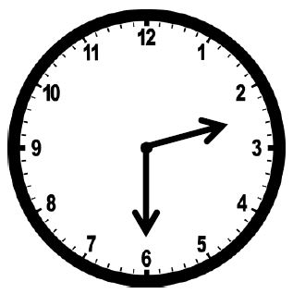
Round 4
Question 6
What time does the clock show?
© Seomra Ranga 2017 www.seomraranga.com

Slide 51
Maths Joke #6
Why did the two 4s skip lunch?
They already 8!
© Seomra Ranga 2017 www.seomraranga.com

Slide 52
ROUND 3 ANSWERS
© Seomra Ranga 2017 www.seomraranga.com

Slide 53
Round 3 Answers
Question 1
Write the number thirty eight.
38
© Seomra Ranga 2017 www.seomraranga.com

Slide 54
Round 3 Answers
Question 2
How many hours in a day?
24
© Seomra Ranga 2017 www.seomraranga.com

Slide 55
Round 3 Answers
Question 3
Which is the longest: (a) season (b) day (c) month (d) week?
Season
© Seomra Ranga 2017 www.seomraranga.com

Slide 56
Round 3 Answers
Question 4
True or False:
2 + 4 + 3 = 3 + 2 + 4
True
© Seomra Ranga 2017 www.seomraranga.com

Slide 57
Round 3 Answers
Question 5
This is cut out from a 100 Square. What number goes in the bottom box?
64
© Seomra Ranga 2017 www.seomraranga.com

Slide 58
Round 3 Answers
Question 6
Which is the most favourite pet in this class?
Dogs
© Seomra Ranga 2017 www.seomraranga.com

Slide 59
Maths Joke #7
Why did the teacher write the maths problem on the window?
She wanted it to be very clear!
© Seomra Ranga 2017 www.seomraranga.com

Slide 60
ROUND 5
© Seomra Ranga 2017 www.seomraranga.com

Slide 61
Round 5
Question 1
True or False: two triangles can make up a rectangle
© Seomra Ranga 2017 www.seomraranga.com

Slide 62
Round 5
Question 2
How many zeroes (0s) in a million? (a) 6 (b) 7 (c) 8
© Seomra Ranga 2017 www.seomraranga.com

Slide 63
Round 5
Question 3
How many days are there in September?
© Seomra Ranga 2017 www.seomraranga.com

Slide 64
Round 5
Question 4
What would you use to measure the length of a football pitch? (a) mm (b) cm (c) m (d) km
© Seomra Ranga 2017 www.seomraranga.com

Slide 65
Round 5
Question 5
In the number 431, what is the value of the 3? (a) 30 (b) 3 (c) 300
© Seomra Ranga 2017 www.seomraranga.com

Slide 66
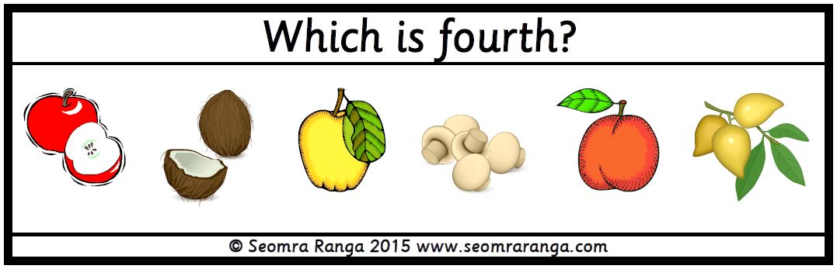
Round 5
Question 6
© Seomra Ranga 2017 www.seomraranga.com

Slide 67
Maths Joke #8
What is the king of the pencil case?
The ruler!
© Seomra Ranga 2017 www.seomraranga.com

Slide 68
ROUND 4 ANSWERS
© Seomra Ranga 2017 www.seomraranga.com

Slide 69
Round 4 Answers
Question 1
True or False: There are eight days in a week?
False
© Seomra Ranga 2017 www.seomraranga.com

Slide 70
Round 4 Answers
Question 2
What is used to measure water? (a) metres (b) kilogrammes (c) litres
Litres
© Seomra Ranga 2017 www.seomraranga.com

Slide 71
Round 4 Answers
Question 3
If you score a hat trick in a match, how many goals do you score?
3
© Seomra Ranga 2017 www.seomraranga.com

Slide 72
Round 4 Answers
Question 4
(20 – 13) – 4 = ?
3
© Seomra Ranga 2017 www.seomraranga.com

Slide 73
Round 4 Answers
Question 5
What is the 10th month of the year?
October
© Seomra Ranga 2017 www.seomraranga.com

Slide 74
Round 4 Answers
Question 6
What time does the clock show?
Half past 2 (2:30)
© Seomra Ranga 2017 www.seomraranga.com

Slide 75
Maths Joke #9
Why was 6 afraid of 7?
Because 7 8 9!
© Seomra Ranga 2017 www.seomraranga.com

Slide 76
ROUND 6
© Seomra Ranga 2017 www.seomraranga.com

Slide 77
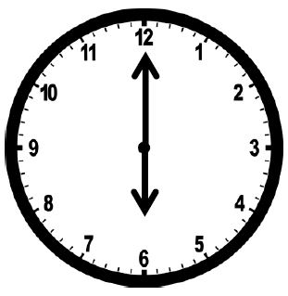
Round 6
Question 1
A movie starts at 6pm and lasts 90 minutes. At what time does it end? (a) 9:00pm (b) 6:30pm (c) 7:30pm (d) 8:30pm
© Seomra Ranga 2017 www.seomraranga.com

Slide 78
Round 6
Question 2
19 - = 11 What number goes in the box?
© Seomra Ranga 2017 www.seomraranga.com

Slide 79
Round 6
Question 3
What is ½ of 12?
© Seomra Ranga 2017 www.seomraranga.com

Slide 80
Round 6
Question 4
Name this 3D shape:
© Seomra Ranga 2017 www.seomraranga.com

Slide 81
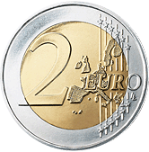
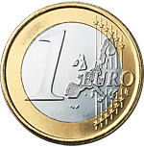


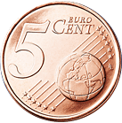
Round 6
Question 5
How much do these coins make?
© Seomra Ranga 2017 www.seomraranga.com

Slide 82
Round 6
Question 6
Add the number of players on a hurling team with the number of players on a basketball team.
© Seomra Ranga 2017 www.seomraranga.com

Slide 83
Maths Joke #10
What did one maths book say to the other?
I don’t know about you, but I’ve got a lot of problems!
© Seomra Ranga 2017 www.seomraranga.com

Slide 84
ROUND 5 ANSWERS
© Seomra Ranga 2017 www.seomraranga.com

Slide 85
Round 5 Answers
Question 1
True or False: two triangles can make up a rectangle
True
© Seomra Ranga 2017 www.seomraranga.com

Slide 86
Round 5 Answers
Question 2
How many zeroes (0s) in a million? (a) 6 (b) 7 (c) 8
6
© Seomra Ranga 2017 www.seomraranga.com

Slide 87
Round 5 Answers
Question 3
How many days are there in September?
30
© Seomra Ranga 2017 www.seomraranga.com

Slide 88
Round 5 Answers
Question 4
What would you use to measure the length of a football pitch? (a) mm (b) cm (c) m (d) km
m (metres)
© Seomra Ranga 2017 www.seomraranga.com

Slide 89
Round 5 Answers
Question 5
In the number 431, what is the value of the 3? (a) 30 (b) 3 (c) 300
30
© Seomra Ranga 2017 www.seomraranga.com

Slide 90
Round 5 Answers
Question 6
mushrooms
© Seomra Ranga 2017 www.seomraranga.com

Slide 91
Maths Joke #11
What did the triangle say to the circle?
You’re pointless!
© Seomra Ranga 2017 www.seomraranga.com

Slide 92
ROUND 6 ANSWERS
© Seomra Ranga 2017 www.seomraranga.com

Slide 93
Round 6 Answers
Question 1
A movie starts at 6pm and lasts 90 minutes. At what time does it end? (a) 9:00pm (b) 6:30pm (c) 7:30pm (d) 8:30pm
7:30pm
© Seomra Ranga 2017 www.seomraranga.com

Slide 94
Round 6 Answers
Question 2
19 - = 11 What number goes in the box?
8
© Seomra Ranga 2017 www.seomraranga.com

Slide 95
Round 6 Answers
Question 3
What is ½ of 12?
6
© Seomra Ranga 2017 www.seomraranga.com

Slide 96
Round 6 Answers
Question 4
Name this 3D shape:
cube
© Seomra Ranga 2017 www.seomraranga.com

Slide 97
Round 6 Answers
Question 5
How much do these coins make?
€3.75
© Seomra Ranga 2017 www.seomraranga.com

Slide 98
Round 6 Answers
Question 6
Add the number of players on a hurling team with the number of players on a basketball team.
20 (15 + 5)
© Seomra Ranga 2017 www.seomraranga.com

Slide 99
Maths Joke #12
I hired a man to do 8 odd-jobs for me.
He only did jobs 1, 3, 5 and 7!
© Seomra Ranga 2017 www.seomraranga.com

Slide 100
TIE BREAK ROUND
© Seomra Ranga 2017 www.seomraranga.com

Slide 101
Tie-Break Round
Question 1
What number is 10 more than 163?
© Seomra Ranga 2017 www.seomraranga.com

Slide 102
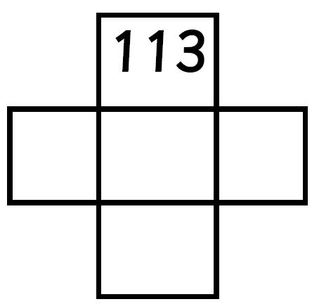
Tie-Break Round
Question 2
This is cut out from a 200 Square. What number goes in the box on the right?
© Seomra Ranga 2017 www.seomraranga.com

Slide 103
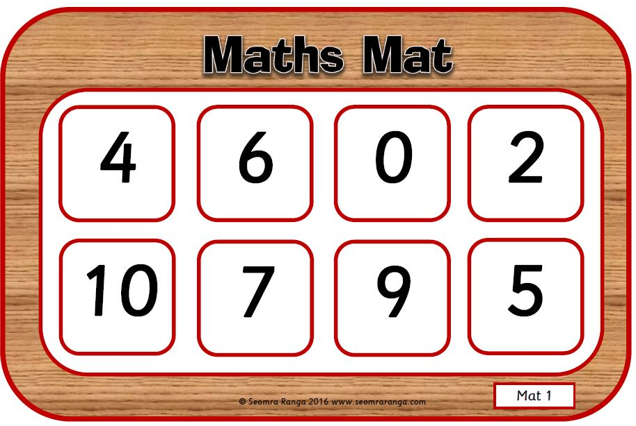
Tie-Break Round
Question 3
What number do you get when you add the four corners of this maths mat?
© Seomra Ranga 2017 www.seomraranga.com

Slide 104


Tie-Break Round
Question 4
How much more do you need to make €2?
© Seomra Ranga 2017 www.seomraranga.com

Slide 105
Tie-Break Round
Question 5
True or False:
20 – 7 > 8 + 3 + 2
© Seomra Ranga 2017 www.seomraranga.com

Slide 106
Tie-Break Round
Question 6
Name this 3D shape
© Seomra Ranga 2017 www.seomraranga.com

Slide 107
TIE BREAK ROUND ANSWERS
© Seomra Ranga 2017 www.seomraranga.com

Slide 108
Tie-Break Round Answers
Question 1
What number is 10 more than 163?
173
© Seomra Ranga 2017 www.seomraranga.com

Slide 109
Tie-Break Round Answers
Question 2
This is cut out from a 200 Square. What number goes in the box on the right?
124
© Seomra Ranga 2017 www.seomraranga.com

Slide 110
Tie-Break Round Answers
Question 3
What number do you get when you add the four corners of this maths mat?
21
© Seomra Ranga 2017 www.seomraranga.com

Slide 111
Tie-Break Round Answers
Question 4
How much more do you need to make €2?
27c
© Seomra Ranga 2017 www.seomraranga.com

Slide 112
Tie-Break Round Answers
Question 5
True or False:
20 – 7 > 8 + 3 + 2
False
© Seomra Ranga 2017 www.seomraranga.com

Slide 113
Tie-Break Round Answers
Question 6
Name this 3D shape
cylinder
© Seomra Ranga 2017 www.seomraranga.com

Slide 114
Hope you all enjoyed the quiz!
© Seomra Ranga 2017 www.seomraranga.com

