Slide 1
The President of Ireland

Slide 2
The Office of President
The Office was established by the Irish Constitution in 1937
The President is the highest office-holder in the country
The functions of the President are performed on the advice of the Government
The President is not answerable to either House of the Oireachtas or to any court in the performance of his or her functions

Slide 3
Electing a President
Any Irish citizen over the age of 35 years can become a Presidential candidate
The term of office is seven years
The President may be re-elected only once
Every citizen of Ireland ordinarily resident in the State who is aged 18 years or over and whose name is entered on the register of electors is entitled to vote

Slide 4
Nomination of Candidates
A candidate must be nominated by either:
(a) not less than 20 members of the Oireachtas (Dáil and Seanad), or
(b) at least 4 county and/or city councils
If only one candidate is nominated, the presidential returning officer declares that candidate elected
If two or more candidates are nominated, an election takes place

Slide 5
Voting for President
The President is elected by the direct vote of the people.
Voting is by secret ballot on the single transferable vote system – this means voters indicate their preference by indicating 1, 2, 3 on the ballot paper.
The names of the candidates appear in alphabetical order on the ballot paper and no political affiliations are given.

Slide 6
Counting of Votes
The counting of votes takes place at 9am on the day after the election
The quota (the number of votes necessary for election) is calculated by the presiding officer in each constituency
Because there is only one position to be filled (President) the quota is 50% of the valid votes +1

Slide 7
Taking up Office
The newly elected President takes up office on the day following the expiration of the term of office of the outgoing President and holds office for seven years from that date
The new President takes up residence in Áras an Uachtaráin in the Phoenix Park, Dublin

Slide 8
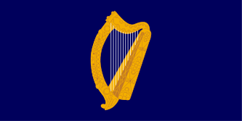
The Presidential Standard
The Irish Presidential Standard, a flag used by the President of Ireland since 1945, shows a golden Cláirseach (Harp) with silver strings on a background of St. Patrick’s Blue. It is flown over the President’s residence, over Dublin Castle when the president is resident there and on vehicles used by the President.

Slide 9
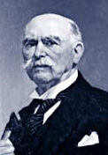
Past Presidents
Douglas Hyde
1938 - 1945

Slide 10
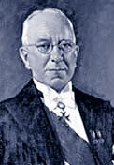
Past Presidents
Seán T. O’ Kelly
1945 - 1959

Slide 11
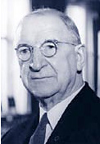
Past Presidents
Eamon de Valera
1959 - 1973

Slide 12
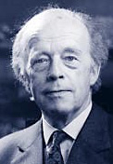
Past Presidents
Erskine Childers
1973 - 1974

Slide 13
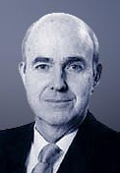
Past Presidents
Cearbhall Ó Dálaigh
1974 - 1976

Slide 14
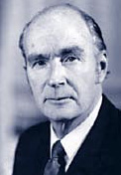
Past Presidents
Patrick Hillery
1976 - 1990

Slide 15
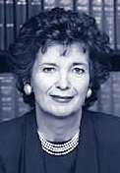
Past Presidents
Mary Robinson
1990 - 1997

Slide 16
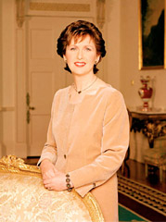
Past Presidents
Mary McAleese
1997 - 2011

Slide 17
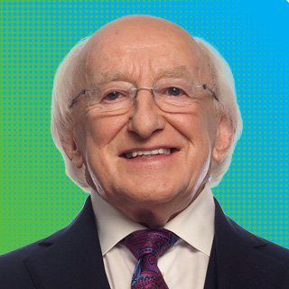
Past Presidents
Michael D. Higgins
2011 - 2018

Slide 18
More Information
For more information on the Irish Presidency visit: https://president.ie/en (English section) or https://president.ie/ga/ (Leagan Gaeilge)
Check out the Children’s Section of the President’s website: https://president.ie/en/childrens-section (English section) or https://president.ie/ga/rannog-na-bpaisti (Leagan Gaeilge)

