Slide 1
Anne Frank
The Diary That Told A Story
© Seomra Ranga 2019 www.seomraranga.com

Slide 2
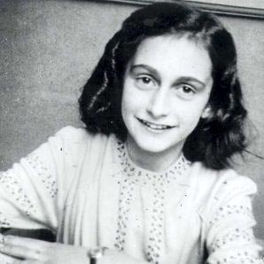
Anne Frank
Anne Frank was born in Germany in 1929.
Anne aged 13
© Seomra Ranga 2019 www.seomraranga.com

Slide 3
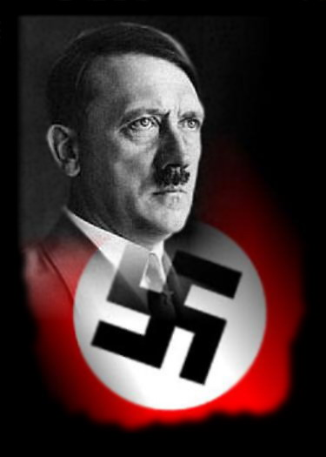
Anne Frank
When she was 4 years old a group of people called the Nazis came to power. Their leader was called Adolf Hitler.
© Seomra Ranga 2019 www.seomraranga.com

Slide 4
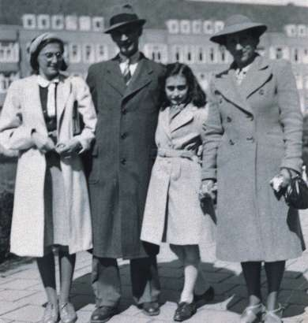
Anne Frank
The Frank family were Jews and the Nazis hated Jews. Anne, her sister Margot and parents, Otto and Edith, had to escape from Germany.
© Seomra Ranga 2019 www.seomraranga.com

Slide 5
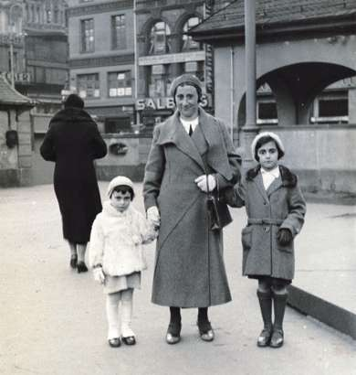
Anne Frank
They went to Holland, but very soon the Nazis had taken over Holland too. The Frank family were in danger as all Jews were being sent to work camps.
The last photo Otto took before the family left Germany
© Seomra Ranga 2019 www.seomraranga.com

Slide 6
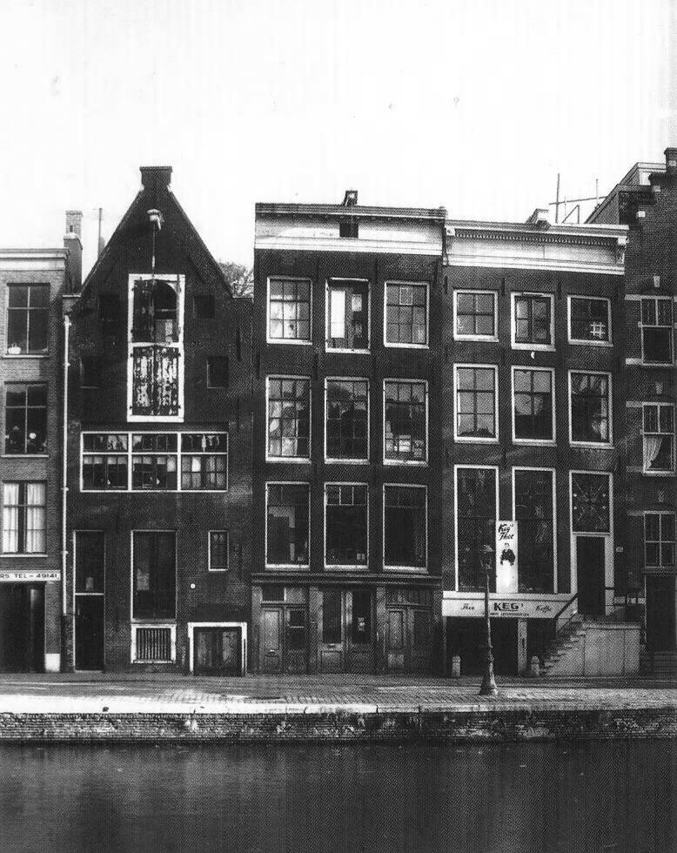
Anne Frank
It was too late for the family to escape so they had to hide instead. For two years, they hid behind a secret door in a tiny room in an old house along with four other people.
The house where the Frank family hid
© Seomra Ranga 2019 www.seomraranga.com

Slide 7
Anne Frank
Jewish families in hiding had to live a life of silence as making noise could give away their hiding place.
Anne’s attic window
© Seomra Ranga 2019 www.seomraranga.com

Slide 8
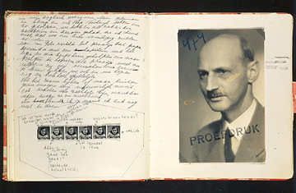
Anne Frank
When she was 13 years old in 1942 Anne received a birthday present of a diary so she began to write in her diary to relieve the boredom.
A page from the Diary of Anne Frank (1944) showing a photograph of her father Otto
© Seomra Ranga 2019 www.seomraranga.com

Slide 9
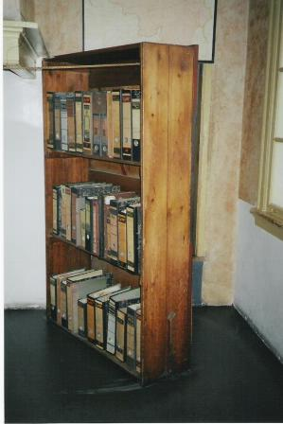
Anne Frank
One day, someone told the Nazis that the Franks were hiding in an old house. The Nazis came and knocked down the secret door.
The secret door is located behind the bookcase
© Seomra Ranga 2019 www.seomraranga.com

Slide 10
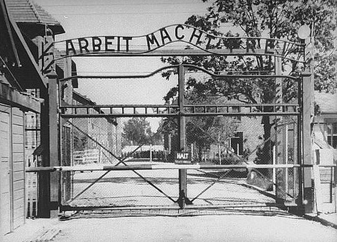
Anne Frank
The Nazis found the Frank family and sent them away to the work camps where they had to perform heavy labour.
The entrance to the Auschwitz-Birkenau work camp
© Seomra Ranga 2019 www.seomraranga.com

Slide 11
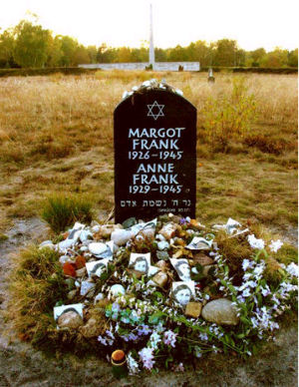
Anne Frank
When the war ended only Otto Frank was still alive. Edith had died of exhaustion and both Margot and Anne had died of typhus.
© Seomra Ranga 2019 www.seomraranga.com

Slide 12
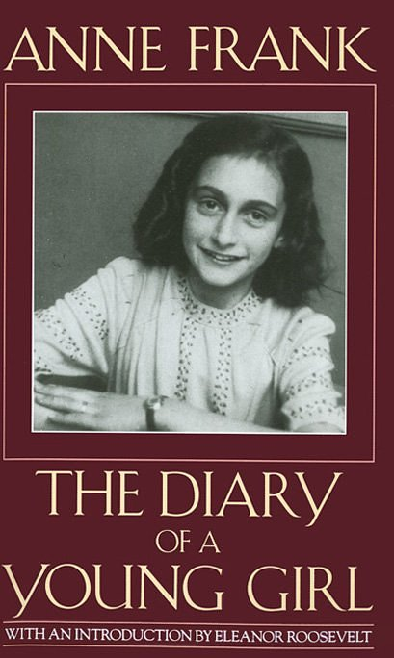
Anne Frank
A friend of Otto Frank had found Anne’s diary and kept it safe. It was later published as a book and it is now one of the most famous diaries in the world.
© Seomra Ranga 2019 www.seomraranga.com

Slide 13
Anne Frank
“Think of all the beauty still left around you and be happy.” (Anne Frank)
© Seomra Ranga 2019 www.seomraranga.com

