Slide 1
Symbols of the Holy Spirit
© Seomra Ranga 2019 www.seomraranga.com

Slide 2
Symbols of the holy spirit
Symbols of the Holy Spirit
A symbol is a shape or a sign that stands for or represents something else. The Bible uses a number of symbols to describe the person and work of the Holy Spirit. These symbols show the nature, character and work of the Holy Spirit.
© Seomra Ranga 2019 www.seomraranga.com

Slide 3
fire
Symbols of the Holy Spirit
Fire gives us light. The Holy Spirit lights up our lives. He shows us the way and helps us to grow.
Fire gives us warmth. The Holy Spirit warms our heart so that we are filled with God’s love for those around us. The Holy Spirit helps us to be warm-hearted.
Fire melts and moulds. The Holy Spirit melts our sins and hardness of heart. He moulds us into the new people that God wants us to be - followers of Jesus.
© Seomra Ranga 2019 www.seomraranga.com

Slide 4
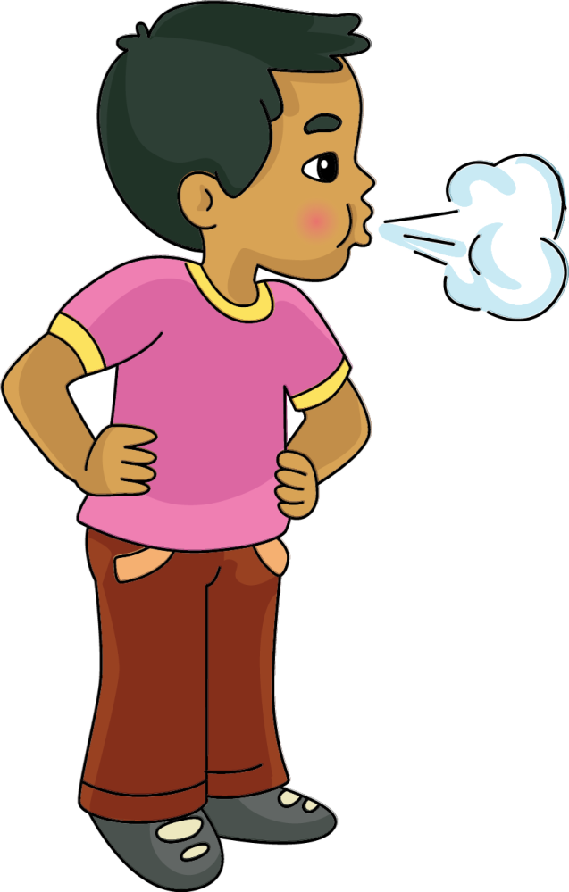
Breath
Symbols of the Holy Spirit
Breath is a sign of life. All living things breathe. The Holy Spirit breathes life into us as children of God.
The Holy Spirit comes first in Baptism. Our physical life begins when we are born. Our spiritual life begins when we are baptised.
The Holy Spirit breathes new life into us at Confirmation.
© Seomra Ranga 2019 www.seomraranga.com

Slide 5
wind
Symbols of the Holy Spirit
Wind can be strong and powerful - it can blow ships out at sea. The Holy Spirit can blow us closer to God.
Wind can destroy. The Holy Spirit can destroy sin and evil.
Wind can be gentle like a summer breeze. The Holy Spirit can be gentle and kind and helps us to be the same.
Wind is refreshing. We feel refreshed when a cool wind blows on a hot summer’s day. The Holy Spirit can refresh us. If we sin, the Holy Spirit can help us to repent. If we are ill he can heal us. If we are worried or have problems he can help us.
© Seomra Ranga 2019 www.seomraranga.com

Slide 6
dove
Symbols of the Holy Spirit
The dove is a symbol of peace. The Holy Spirit brings peace into our lives.
© Seomra Ranga 2019 www.seomraranga.com

Slide 7
Symbols of the Holy Spirit
Resources used in this file from:
https://www.teacherspayteachers.com/Store/Henmama-Designs
https://www.teacherspayteachers.com/Store/Whimsy-Clips
https://www.teacherspayteachers.com/Store/Ramonam-Graphics
© Seomra Ranga 2019 www.seomraranga.com

