Slide 1
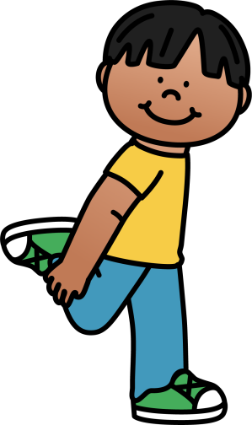
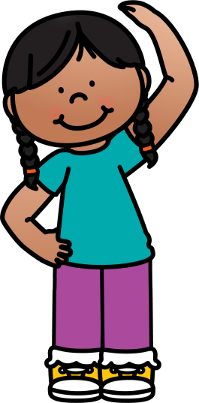
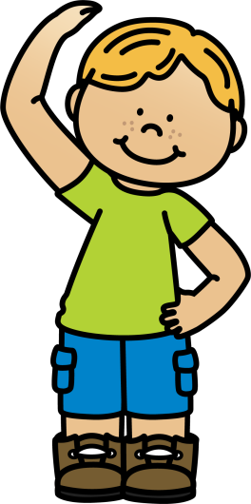
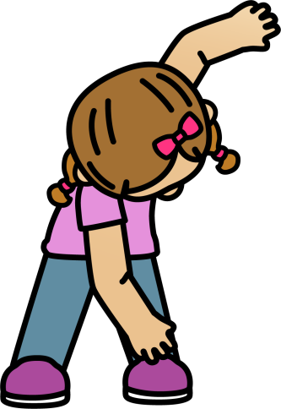
10 @ 10
10 simple exercises to do in the classroom at 10am every morning
© Seomra Ranga 2019 www.seomraranga.com

Slide 2
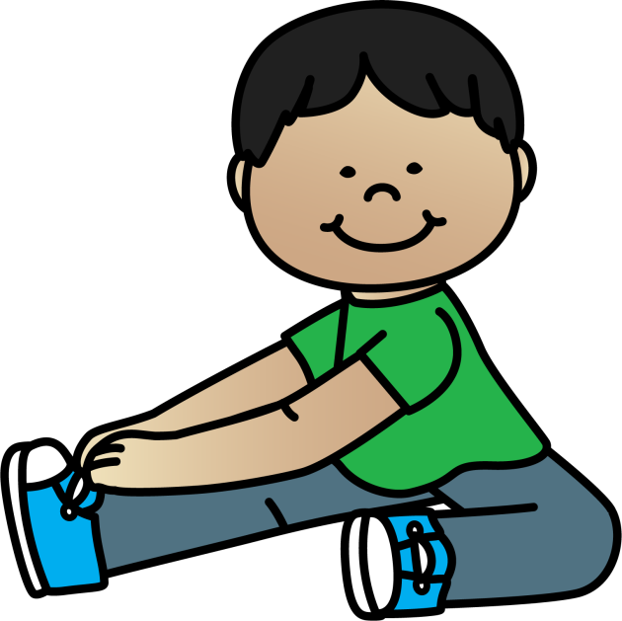
10 @ 10
10
Repeat
#1
Leg Stretch
© Seomra Ranga 2019 www.seomraranga.com

Slide 3
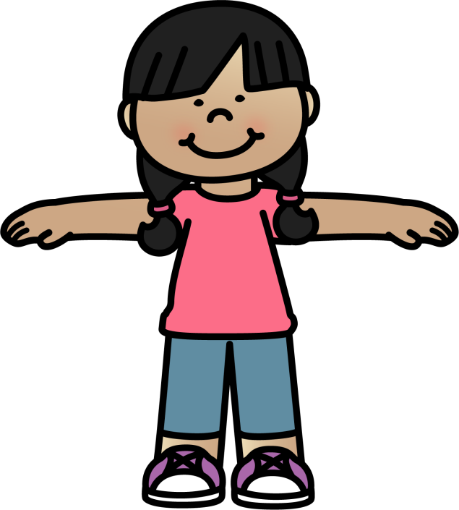
10 @ 10
10
Repeat
#2
Arm Circles
© Seomra Ranga 2019 www.seomraranga.com

Slide 4
10 @ 10
10
Repeat
#3
Quad Stretch
© Seomra Ranga 2019 www.seomraranga.com

Slide 5
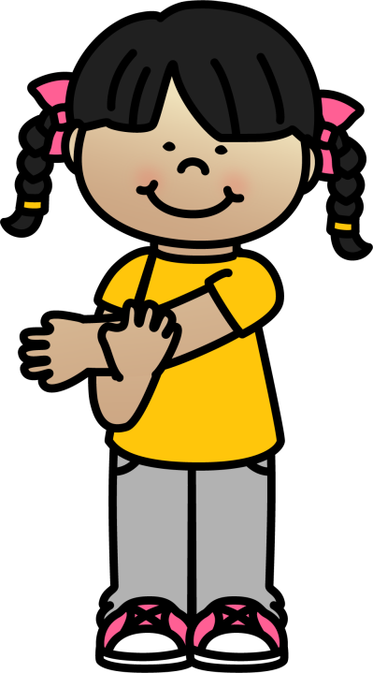
10 @ 10
10
Repeat
#4
Shoulder Stretch
© Seomra Ranga 2019 www.seomraranga.com

Slide 6
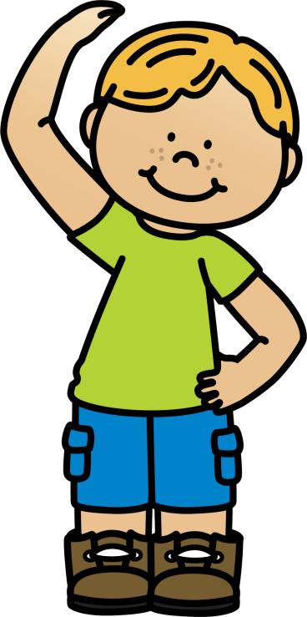
10 @ 10
10
Repeat
#5
Side Bends
© Seomra Ranga 2019 www.seomraranga.com

Slide 7
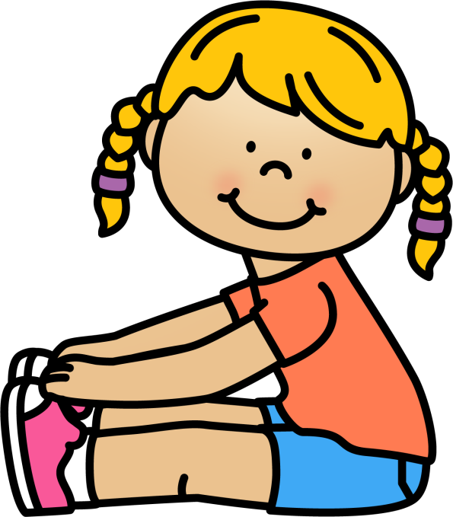
10 @ 10
10
Repeat
#6
Touch Toes
© Seomra Ranga 2019 www.seomraranga.com

Slide 8
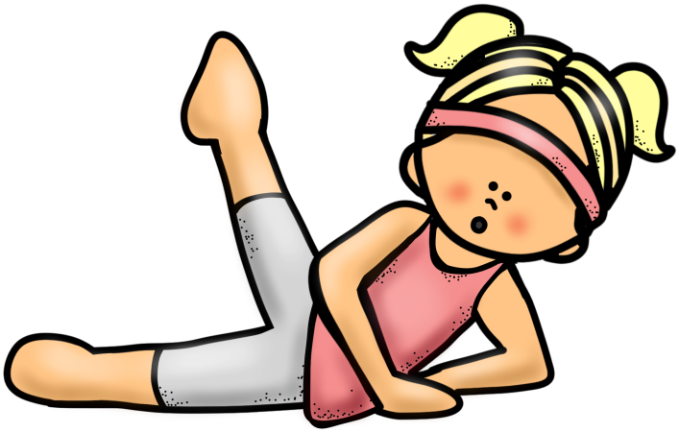
10 @ 10
10
Repeat
#7
Leg Stretches
© Seomra Ranga 2019 www.seomraranga.com

Slide 9
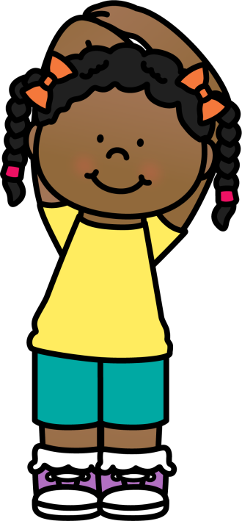
10 @ 10
10
Repeat
#8
Tricep Stretch
© Seomra Ranga 2019 www.seomraranga.com

Slide 10
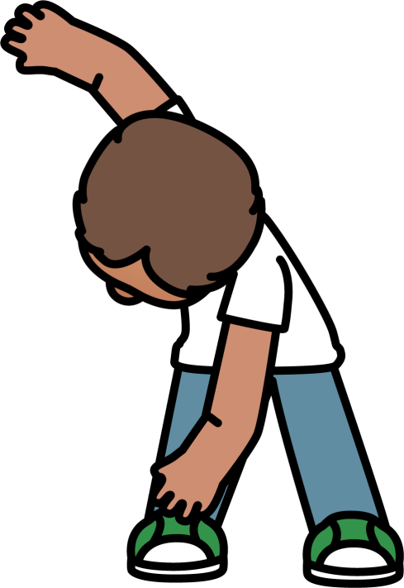
10 @ 10
10
Repeat
#9
Touch Toes
© Seomra Ranga 2019 www.seomraranga.com

Slide 11
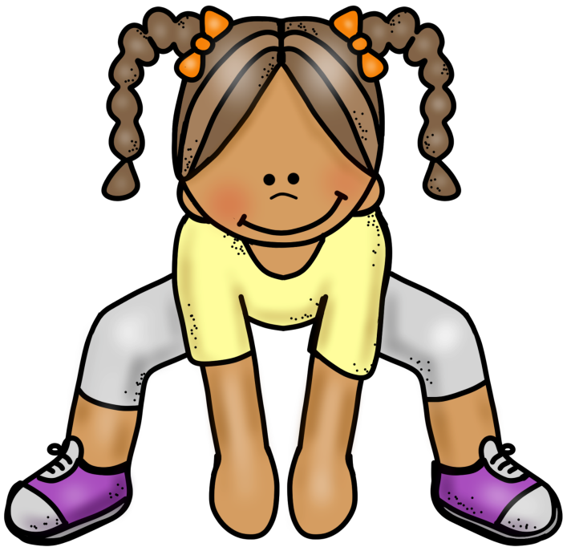
10 @ 10
10
Repeat
#10
Sumo Squats
© Seomra Ranga 2019 www.seomraranga.com

Slide 12
10 @ 10
Resources used in this file from:
https://www.teacherspayteachers.com/Store/Educlips
https://www.teacherspayteachers.com/Store/Whimsy-Clips
© Seomra Ranga 2019 www.seomraranga.com

