Slide 1
MATHS WEEK 2019
TABLE
QUIZ
© Seomra Ranga 2019 www.seomraranga.com

Slide 2
Before You Start
Make sure you have written your table/team number/letter on every answer sheet
Write the number of each round 1-8 on every answer sheet
Try not to shout out answers
Check with your team mates and agree an answer before you write it down
© Seomra Ranga 2019 www.seomraranga.com

Slide 3
Before You Start
Don’t worry about spellings – just do your best
If you’re not sure of the answer, make your best possible guess
It might be a good idea to have a piece of paper to do some rough calculations for some questions
Good luck and enjoy the quiz
© Seomra Ranga 2019 www.seomraranga.com

Slide 4
Maths Puzzle
Throughout the quiz, at the end of each Round and Answer Round, you will be given a letter which is part of a mathematical term/phrase. Save these letters until the end of Round 8. Then use the clue to unjumble all sixteen letters to discover the mathematical term/phrase.
© Seomra Ranga 2019 www.seomraranga.com

Slide 5
Round 1
© Seomra Ranga 2019 www.seomraranga.com

Slide 6
Round 1
Question 1
Make the largest number possible using these digits:
2
9
6
4
8
1
© Seomra Ranga 2019 www.seomraranga.com

Slide 7
Round 1
Question 2
How many degrees are in a full rotation?
© Seomra Ranga 2019 www.seomraranga.com

Slide 8
Round 1
Question 3
Write the number one million, ten thousand and eleven.
© Seomra Ranga 2019 www.seomraranga.com

Slide 9
Round 1
Question 4
What is 6.7 X 1000?
© Seomra Ranga 2019 www.seomraranga.com

Slide 10
Round 1
Question 5
What is this maths puzzle called?
© Seomra Ranga 2019 www.seomraranga.com

Slide 11
Round 1
Question 6
Mark is 12 years old. His sister is double his age and his brother is half his age. What is the total of all of their ages?
© Seomra Ranga 2019 www.seomraranga.com

Slide 12
Maths Puzzle Letter
G
Save the letter, put it with all of the others to solve the mathematical term at the end of the quiz
© Seomra Ranga 2019 www.seomraranga.com

Slide 13
Round 2
© Seomra Ranga 2019 www.seomraranga.com

Slide 14
Round 2
Question 1
How many 20c coins make up €8.40?
© Seomra Ranga 2019 www.seomraranga.com

Slide 15
Round 2
Question 2
What type of angle is this: acute, obtuse or reflex?
© Seomra Ranga 2019 www.seomraranga.com

Slide 16
Round 2
Question 3
€25 - €6.83
© Seomra Ranga 2019 www.seomraranga.com

Slide 17
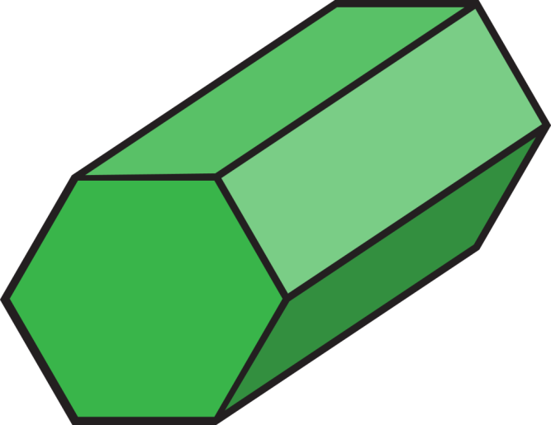
Round 2
Question 4
Name this 3D shape:
© Seomra Ranga 2019 www.seomraranga.com

Slide 18
Round 2
Question 5
In the word “SPHERE”, which letters are symmetrical?
© Seomra Ranga 2019 www.seomraranga.com

Slide 19
Round 2
Question 6
I am an odd number. Take away one letter and I become even. What number am I?
© Seomra Ranga 2019 www.seomraranga.com

Slide 20
Maths Puzzle Letter
N
Save the letter, put it with all of the others to solve the mathematical term at the end of the quiz
© Seomra Ranga 2019 www.seomraranga.com

Slide 21
Round 1 Answers
© Seomra Ranga 2019 www.seomraranga.com

Slide 22
Round 1 Answers
Question 1
Make the largest number possible using these digits:
2
9
6
4
8
1
986,421
© Seomra Ranga 2019 www.seomraranga.com

Slide 23
Round 1 Answers
Question 2
How many degrees are in a full rotation?
360⁰
© Seomra Ranga 2019 www.seomraranga.com

Slide 24
Round 1 Answers
Question 3
Write the number one million, ten thousand and eleven.
1,010,011
© Seomra Ranga 2019 www.seomraranga.com

Slide 25
Round 1 Answers
Question 4
What is 6.7 X 1000
6,700
© Seomra Ranga 2019 www.seomraranga.com

Slide 26
Round 1 Answers
Question 5
What is this maths puzzle called?
Tangram
© Seomra Ranga 2019 www.seomraranga.com

Slide 27
Round 1 Answers
Question 6
Mark is 12 years old. His sister is double his age and his brother is half his age. What is the total of all of their ages?
42 (6+12+24)
© Seomra Ranga 2019 www.seomraranga.com

Slide 28
Maths Puzzle Letter
R
Save the letter, put it with all of the others to solve the mathematical term at the end of the quiz
© Seomra Ranga 2019 www.seomraranga.com

Slide 29
Round 3
© Seomra Ranga 2019 www.seomraranga.com

Slide 30
Round 3
Question 1
How many days in a fortnight?
© Seomra Ranga 2019 www.seomraranga.com

Slide 31
Round 3
Question 2
How many cm in 2.6m?
© Seomra Ranga 2019 www.seomraranga.com

Slide 32
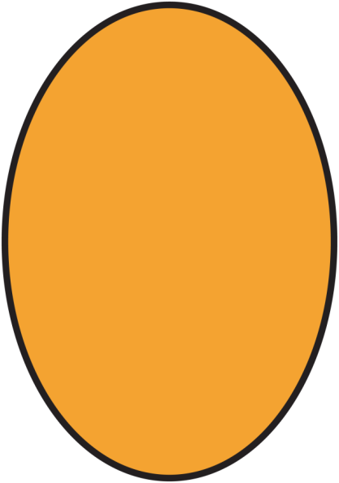
Round 3
Question 3
Yes or no: Will an oval tessellate?
© Seomra Ranga 2019 www.seomraranga.com

Slide 33
Round 3
Question 4
What is the chance of being born on a Tuesday? (give your answer in ratio)
© Seomra Ranga 2019 www.seomraranga.com

Slide 34
Round 3
Question 5
In a Leap Year, if February 24th is a Thursday, What day is March 3rd?
© Seomra Ranga 2019 www.seomraranga.com

Slide 35
Round 3
Question 6
How many degrees are there in angle X?
X⁰
35⁰
© Seomra Ranga 2019 www.seomraranga.com

Slide 36
Maths Puzzle Letter
I
Save the letter, put it with all of the others to solve the mathematical term at the end of the quiz
© Seomra Ranga 2019 www.seomraranga.com

Slide 37
Round 2 Answers
© Seomra Ranga 2019 www.seomraranga.com

Slide 38
Round 2 Answers
Question 1
How many 20c coins make up €8.40?
42
© Seomra Ranga 2019 www.seomraranga.com

Slide 39
Round 2 Answers
Question 2
What type of angle is this: acute, obtuse or reflex?
Reflex
© Seomra Ranga 2019 www.seomraranga.com

Slide 40
Round 2 Answers
Question 3
€25 - €6.83
€18.17
© Seomra Ranga 2019 www.seomraranga.com

Slide 41
Round 2 Answers
Question 4
Name this 3D shape:
Hexagonal
Prism
© Seomra Ranga 2019 www.seomraranga.com

Slide 42
Round 2 Answers
Question 5
In the word “SPHERE”, which letters are symmetrical?
H, E
© Seomra Ranga 2019 www.seomraranga.com

Slide 43
Round 2 Answers
Question 6
I am an odd number. Take away one letter and I become even. What number am I?
Seven
© Seomra Ranga 2019 www.seomraranga.com

Slide 44
Maths Puzzle Letter
T
Save the letter, put it with all of the others to solve the mathematical term at the end of the quiz
© Seomra Ranga 2019 www.seomraranga.com

Slide 45
Round 4
© Seomra Ranga 2019 www.seomraranga.com

Slide 46
Round 4
Question 1
What fraction of this shape is not shaded?
© Seomra Ranga 2019 www.seomraranga.com

Slide 47
Round 4
Question 2
What is the next number in this sequence:
3
9
27
?
© Seomra Ranga 2019 www.seomraranga.com

Slide 48
Round 4
Question 3
40 X ⅜
© Seomra Ranga 2019 www.seomraranga.com

Slide 49
Round 4
Question 4
If A=1, B=2, C=3 etc., what is the value of the word MATHS?
© Seomra Ranga 2019 www.seomraranga.com

Slide 50
Round 4
Question 5
How many B boxes fit into A?
4
A
B
2
2
1
4
1
© Seomra Ranga 2019 www.seomraranga.com

Slide 51
Round 4
Question 6
A car uses 1L of petrol every 12Km. How many L will it use if it travels 96Km?
© Seomra Ranga 2019 www.seomraranga.com

Slide 52
Maths Puzzle Letter
U
Save the letter, put it with all of the others to solve the mathematical term at the end of the quiz
© Seomra Ranga 2019 www.seomraranga.com

Slide 53
Round 3 Answers
© Seomra Ranga 2019 www.seomraranga.com

Slide 54
Round 3 Answers
Question 1
How many days in a fortnight?
14
© Seomra Ranga 2019 www.seomraranga.com

Slide 55
Round 3 Answers
Question 2
How many cm in 2.6m?
260cm
© Seomra Ranga 2019 www.seomraranga.com

Slide 56
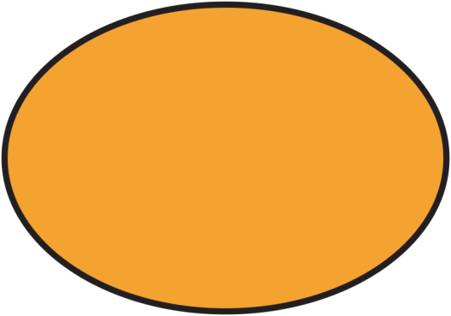
Round 3 Answers
Question 3
Yes or no: Will an oval tessellate?
No
© Seomra Ranga 2019 www.seomraranga.com

Slide 57
Round 3 Answers
Question 4
What is the chance of being born on a Tuesday? (give your answer in ratio)
1:7
© Seomra Ranga 2019 www.seomraranga.com

Slide 58
Round 3 Answers
Question 5
In a Leap Year, if February 24th is a Thursday, What day is March 3rd?
Friday
© Seomra Ranga 2019 www.seomraranga.com

Slide 59
Round 3 Answers
Question 6
How many degrees are there in angle X?
X⁰
35⁰
145⁰
© Seomra Ranga 2019 www.seomraranga.com

Slide 60
Maths Puzzle Letter
M
Save the letter, put it with all of the others to solve the mathematical term at the end of the quiz
© Seomra Ranga 2019 www.seomraranga.com

Slide 61
Round 5
© Seomra Ranga 2019 www.seomraranga.com

Slide 62
Round 5
Question 1
Write the number fifty nine thousand and fifty.
© Seomra Ranga 2019 www.seomraranga.com

Slide 63
Round 5
Question 2
How many eggs are there in 2½ dozen?
© Seomra Ranga 2019 www.seomraranga.com

Slide 64
Round 5
Question 3
Which of these is not a multiple of 5:
15
40
52
65
75
90
© Seomra Ranga 2019 www.seomraranga.com

Slide 65
Round 5
Question 4
Is 10¹⁵ (a) billion (b) trillion (c) quadrillion?
© Seomra Ranga 2019 www.seomraranga.com

Slide 66
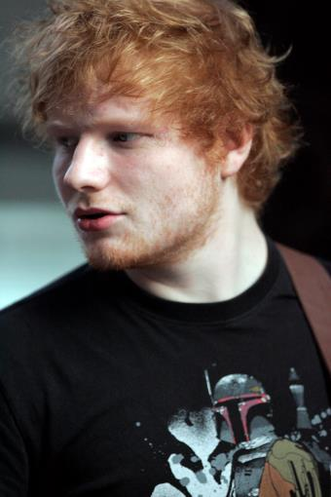
Round 5
Question 5
Ed Sheeran was born on February 17th, 1991. What age is he today? (in full years)
© Seomra Ranga 2019 www.seomraranga.com

Slide 67
Round 5
Question 6
Using only addition, how do you add eight 8s and get the number 1000?
© Seomra Ranga 2019 www.seomraranga.com

Slide 68
Maths Puzzle Letter
A
Save the letter, put it with all of the others to solve the mathematical term at the end of the quiz
© Seomra Ranga 2019 www.seomraranga.com

Slide 69
Round 4 Answers
© Seomra Ranga 2019 www.seomraranga.com

Slide 70
Round 4 Answers
Question 1
What fraction of this shape is not shaded?
¼
© Seomra Ranga 2019 www.seomraranga.com

Slide 71
Round 4 Answers
Question 2
What is the next number in this sequence:
3
9
27
?
81
© Seomra Ranga 2019 www.seomraranga.com

Slide 72
Round 4 Answers
Question 3
40 X ⅜
15
© Seomra Ranga 2019 www.seomraranga.com

Slide 73
Round 4 Answers
Question 4
If A=1, B=2, C=3 etc., what is the value of the word MATHS?
61 (13+1+20+8+19)
© Seomra Ranga 2019 www.seomraranga.com

Slide 74
Round 4 Answers
Question 5
How many B boxes fit into A?
4
A
B
2
16 (32÷2)
2
1
4
1
© Seomra Ranga 2019 www.seomraranga.com

Slide 75
Round 4 Answers
Question 6
A car uses 1L of petrol every 12Km. How many L will it use if it travels 96Km?
8L
© Seomra Ranga 2019 www.seomraranga.com

Slide 76
Maths Puzzle Letter
E
Save the letter, put it with all of the others to solve the mathematical term at the end of the quiz
© Seomra Ranga 2019 www.seomraranga.com

Slide 77
Round 6
© Seomra Ranga 2019 www.seomraranga.com

Slide 78
Round 6
Question 1
What is the next Prime Number after 7?
© Seomra Ranga 2019 www.seomraranga.com

Slide 79
Round 6
Question 2
The ukulele is on sale with a 20% discount. What is the sale price?
€180
© Seomra Ranga 2019 www.seomraranga.com

Slide 80
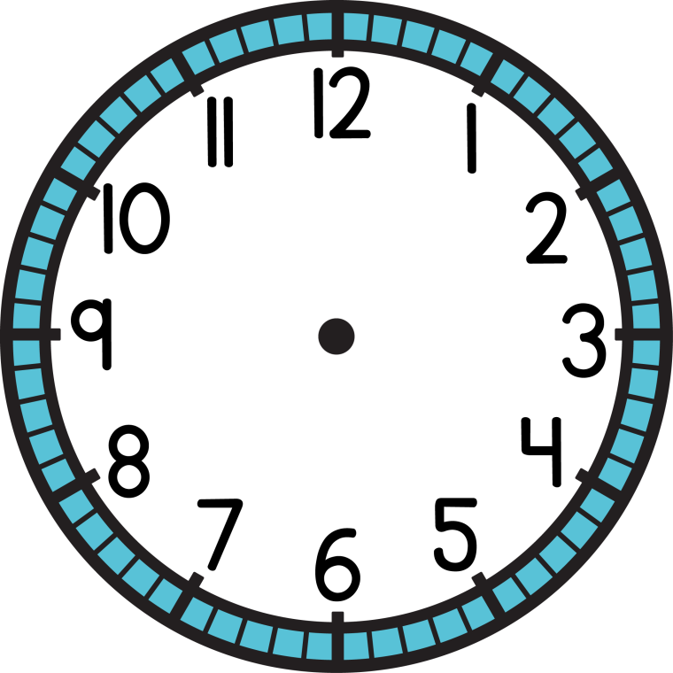
Round 6
Question 3
What is the time on this clock (pm) in 24hr digital time?
© Seomra Ranga 2019 www.seomraranga.com

Slide 81
Round 6
Question 4
True or False: 142,857 X 7 = 999,999
© Seomra Ranga 2019 www.seomraranga.com

Slide 82
Round 6
Question 5
What 2D shape has 4 equal sides, 2 acute angles and 2 obtuse angles?
© Seomra Ranga 2019 www.seomraranga.com

Slide 83
Round 6
Question 6
X
=
144
+
=
35
X
=
22
=
?
+
© Seomra Ranga 2019 www.seomraranga.com

Slide 84
Maths Puzzle Letter
R
Save the letter, put it with all of the others to solve the mathematical term at the end of the quiz
© Seomra Ranga 2019 www.seomraranga.com

Slide 85
Round 5 Answers
© Seomra Ranga 2019 www.seomraranga.com

Slide 86
Round 5 Answers
Question 1
Write the number fifty nine thousand and fifty.
59,050
© Seomra Ranga 2019 www.seomraranga.com

Slide 87
Round 5 Answers
Question 2
How many eggs are there in 2½ dozen?
30
© Seomra Ranga 2019 www.seomraranga.com

Slide 88
Round 5 Answers
Question 3
Which of these is not a multiple of 5:
15
40
52
65
75
90
52
© Seomra Ranga 2019 www.seomraranga.com

Slide 89
Round 5 Answers
Question 4
Is 10¹⁵ (a) billion (b) trillion (c) quadrillion?
Quadrillion
© Seomra Ranga 2019 www.seomraranga.com

Slide 90
Round 5 Answers
Question 5
Ed Sheeran was born on February 17th, 1991. What age is he today? (in full years)
28
© Seomra Ranga 2019 www.seomraranga.com

Slide 91
Round 5 Answers
Question 6
Using only addition, how do you add eight 8s and get the number 1000?
888 + 88 + 8 + 8 + 8
© Seomra Ranga 2019 www.seomraranga.com

Slide 92
Maths Puzzle Letter
L
Save the letter, put it with all of the others to solve the mathematical term at the end of the quiz
© Seomra Ranga 2019 www.seomraranga.com

Slide 93
Round 7
© Seomra Ranga 2019 www.seomraranga.com

Slide 94
Round 7
Question 1
What 2D shape is this a net of?
© Seomra Ranga 2019 www.seomraranga.com

Slide 95
Round 7
Question 2
7 cupcakes cost €15.40. What is the price of one cupcake?
© Seomra Ranga 2019 www.seomraranga.com

Slide 96
Round 7
Question 3
What change do you get from €50 after buying 6 bears?
€7.25
© Seomra Ranga 2019 www.seomraranga.com

Slide 97
Round 7
Question 4
What is half of the 7th Prime Number?
© Seomra Ranga 2019 www.seomraranga.com

Slide 98
Round 7
Question 5
True or False: 111111111 X 111111111 = 12345678987654321
© Seomra Ranga 2019 www.seomraranga.com

Slide 99
Round 7
Question 6
The ages of a father and daughter add up to 66. The father’s age is the daughter’s age reversed. How old could they be? (give one of the three possible answers)
© Seomra Ranga 2019 www.seomraranga.com

Slide 100
Maths Puzzle Letter
R
Save the letter, put it with all of the others to solve the mathematical term at the end of the quiz
© Seomra Ranga 2019 www.seomraranga.com

Slide 101
Round 6 Answers
© Seomra Ranga 2019 www.seomraranga.com

Slide 102
Round 6 Answers
Question 1
What is the next Prime Number after 7?
11
© Seomra Ranga 2019 www.seomraranga.com

Slide 103
Round 6 Answers
Question 2
The ukulele is on sale with a 20% discount. What is the sale price?
€180
€144
© Seomra Ranga 2019 www.seomraranga.com

Slide 104
Round 6 Answers
Question 3
What is the time on this clock (pm) in 24hr digital time?
21
35
© Seomra Ranga 2019 www.seomraranga.com

Slide 105
Round 6 Answers
Question 4
True or False: 142,857 X 7 = 999,999
True
© Seomra Ranga 2019 www.seomraranga.com

Slide 106
Round 6 Answers
Question 5
What 2D shape has 4 equal sides, 2 acute angles and 2 obtuse angles?
Rhombus
© Seomra Ranga 2019 www.seomraranga.com

Slide 107
Round 6 Answers
Question 6
X
=
144
+
=
35
16
X
=
22
=
?
+
© Seomra Ranga 2019 www.seomraranga.com

Slide 108
Maths Puzzle Letter
U
Save the letter, put it with all of the others to solve the mathematical term at the end of the quiz
© Seomra Ranga 2019 www.seomraranga.com

Slide 109
Round 8
© Seomra Ranga 2019 www.seomraranga.com

Slide 110
Round 8
Question 1
Name this 3D shape:
© Seomra Ranga 2019 www.seomraranga.com

Slide 111
Round 8
Question 2
In a row of houses, the middle house is No. 19. What is the number of the last house?
© Seomra Ranga 2019 www.seomraranga.com

Slide 112
Round 8
Question 3
The average of 3 numbers is 20. Two of the numbers are 19 and 23. What is the 3rd number?
© Seomra Ranga 2019 www.seomraranga.com

Slide 113
Round 8
Question 4
List all of the factors of 16.
© Seomra Ranga 2019 www.seomraranga.com

Slide 114
Round 8
Question 5
What is the chance of picking a yellow ball from the box?
© Seomra Ranga 2019 www.seomraranga.com

Slide 115
Round 8
Question 6
A brick weighs 1Kg plus half of the brick. What is the weight of one brick?
© Seomra Ranga 2019 www.seomraranga.com

Slide 116
Maths Puzzle Letter
B
Save the letter, put it with all of the others to solve the mathematical term at the end of the quiz
© Seomra Ranga 2019 www.seomraranga.com

Slide 117
Round 7 Answers
© Seomra Ranga 2019 www.seomraranga.com

Slide 118
Round 7 Answers
Question 1
What 2D shape is this a net of?
Cylinder
© Seomra Ranga 2019 www.seomraranga.com

Slide 119
Round 7 Answers
Question 2
7 cupcakes cost €15.40. What is the price of one cupcake?
€2.20
© Seomra Ranga 2019 www.seomraranga.com

Slide 120
Round 7 Answers
Question 3
What change do you get from €50 after buying 6 bears?
€7.25
€6.50
© Seomra Ranga 2019 www.seomraranga.com

Slide 121
Round 7 Answers
Question 4
What is half of the 7th Prime Number?
8.5
© Seomra Ranga 2019 www.seomraranga.com

Slide 122
Round 7 Answers
Question 5
True or False: 111111111 X 111111111 = 12345678987654321
True
© Seomra Ranga 2019 www.seomraranga.com

Slide 123
Round 7 Answers
Question 6
The ages of a father and daughter add up to 66. The father’s age is the daughter’s age reversed. How old could they be? (give one of the three possible answers)
51/15; 42/24; 60/06
© Seomra Ranga 2019 www.seomraranga.com

Slide 124
Maths Puzzle Letter
N
Save the letter, put it with all of the others to solve the mathematical term at the end of the quiz
© Seomra Ranga 2019 www.seomraranga.com

Slide 125
Round 8 Answers
© Seomra Ranga 2019 www.seomraranga.com

Slide 126
Round 8 Answers
Question 1
Name this 3D shape:
Square-Based Pyramid
© Seomra Ranga 2019 www.seomraranga.com

Slide 127
Round 8 Answers
Question 2
In a row of houses, the middle house is No. 19. What is the number of the last house?
37
© Seomra Ranga 2019 www.seomraranga.com

Slide 128
Round 8 Answers
Question 3
The average of 3 numbers is 20. Two of the numbers are 19 and 23. What is the 3rd number?
18
© Seomra Ranga 2019 www.seomraranga.com

Slide 129
Round 8 Answers
Question 4
List all of the factors of 16.
1, 2, 4, 8, 16
© Seomra Ranga 2019 www.seomraranga.com

Slide 130
Round 8 Answers
Question 5
What is the chance of picking a yellow ball from the box?
1:5
© Seomra Ranga 2019 www.seomraranga.com

Slide 131
Round 8 Answers
Question 6
A brick weighs 1Kg plus half of the brick. What is the weight of one brick?
2Kg
© Seomra Ranga 2019 www.seomraranga.com

Slide 132
Maths Puzzle Letter
A
Save the letter, put it with all of the others to solve the mathematical term at the end of the quiz
© Seomra Ranga 2019 www.seomraranga.com

Slide 133
Maths Puzzle
Now that you have collected all 16 letters in today’s Maths Puzzle, can you unscramble them?
The answer is a mathematical term with two words.
T_ _ _ _ _ _ _ A _ /
N _ _ _ _ _
© Seomra Ranga 2019 www.seomraranga.com

Slide 134
Maths Puzzle Answer
Triangular Number
© Seomra Ranga 2019 www.seomraranga.com

Slide 135
Tie-Break Round
© Seomra Ranga 2019 www.seomraranga.com

Slide 136
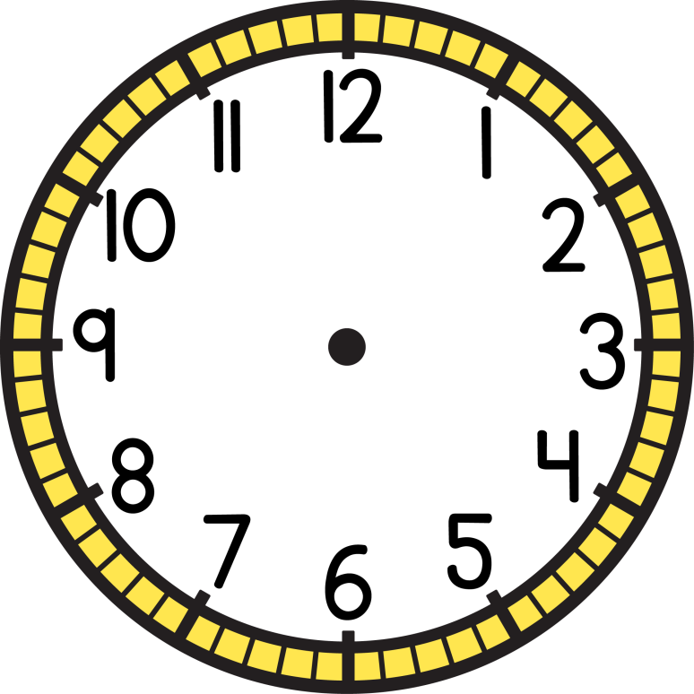
Tie-Break Round
Question 1
How many minutes in 5¾ hours?
© Seomra Ranga 2019 www.seomraranga.com

Slide 137
Tie-Break Round
Question 2
Increase €320 by 0.1
© Seomra Ranga 2019 www.seomraranga.com

Slide 138
Tie-Break Round
Question 3
30% of a number is 36. What is the number?
© Seomra Ranga 2019 www.seomraranga.com

Slide 139
Tie-Break Round
Question 4
475 sweets were packed into bags of 9. When all of the bags were packed, how many sweets were left over?
© Seomra Ranga 2019 www.seomraranga.com

Slide 140
Tie-Break Round
Question 5
A TV programme finished at 11:15pm. If it lasted 2hrs 25mins, at what time did it start?
© Seomra Ranga 2019 www.seomraranga.com

Slide 141
Tie-Break Round
Question 6
0.0021 X 10,000
© Seomra Ranga 2019 www.seomraranga.com

Slide 142
Tie-Break Answers
© Seomra Ranga 2019 www.seomraranga.com

Slide 143
Tie-Break Answers
Question 1
How many minutes in 5¾ hours?
345mins
© Seomra Ranga 2019 www.seomraranga.com

Slide 144
Tie-Break Answers
Question 2
Increase €320 by 0.1
352
© Seomra Ranga 2019 www.seomraranga.com

Slide 145
Tie-Break Answers
Question 3
30% of a number is 36. What is the number?
120
© Seomra Ranga 2019 www.seomraranga.com

Slide 146
Tie-Break Answers
Question 4
475 sweets were packed into bags of 9. When all of the bags were packed, how many sweets were left over?
7
© Seomra Ranga 2019 www.seomraranga.com

Slide 147
Tie-Break Answers
Question 5
A TV programme finished at 11:15pm. If it lasted 2hrs 25mins, at what time did it start?
8:50pm
© Seomra Ranga 2019 www.seomraranga.com

Slide 148
Tie-Break Answers
Question 6
0.0021 X 10,000
21
© Seomra Ranga 2019 www.seomraranga.com

Slide 149
Hope you all enjoyed the quiz!
© Seomra Ranga 2019 www.seomraranga.com

Slide 150
Resources used in this file from:
https://depositphotos.com/
https://www.teacherspayteachers.com/Store/Whimsy-Clips
https://www.teacherspayteachers.com/Store/Laine-Sutherland-Designs
https://www.teacherspayteachers.com/Store/Educlips
https://www.teacherspayteachers.com/Store/Krista-Wallden-Creative-Clips
© Seomra Ranga 2019 www.seomraranga.com

