Slide 1
Africa Table Quiz
© Seomra Ranga 2020 www.seomraranga.com

Slide 2
Before You Start
Make sure you have written your table/team number/letter on every answer sheet
Write the number of each round 1-8 on every answer sheet
Try not to shout out answers
Check with your team mates and agree an answer before you write it down
© Seomra Ranga 2020 www.seomraranga.com

Slide 3
Before You Start
Don’t worry about spellings – just do your best
If you’re not sure of the answer, make your best possible guess
Good luck and enjoy the quiz
© Seomra Ranga 2020 www.seomraranga.com

Slide 4
Round 1
© Seomra Ranga 2020 www.seomraranga.com

Slide 5
Round 1
Question 1
What is a female lion called?
© Seomra Ranga 2020 www.seomraranga.com

Slide 6
Round 1
Question 2
What is the group name for a family of elephants?
© Seomra Ranga 2020 www.seomraranga.com

Slide 7
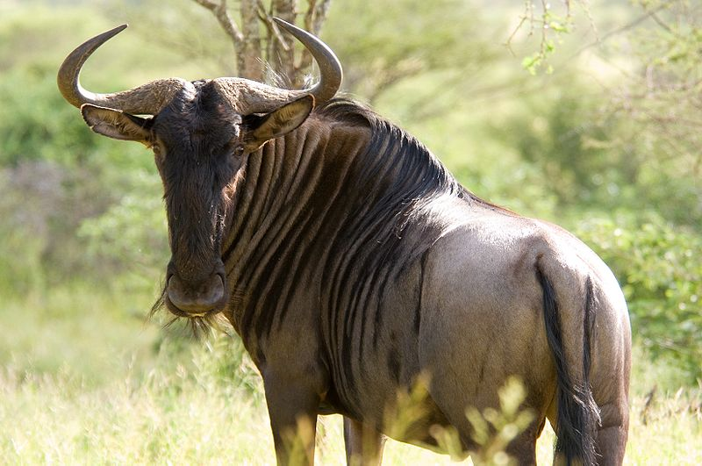
Round 1
Question 2
Name this wild animal found in Africa?
© Seomra Ranga 2020 www.seomraranga.com

Slide 8
Round 1
Question 4
Which animal in “Handa’s Surprise” took the orange?
© Seomra Ranga 2020 www.seomraranga.com

Slide 9
Round 1
Question 5
What is the highest mountain in Africa?
© Seomra Ranga 2020 www.seomraranga.com

Slide 10
Round 1
Question 6
English and what other language are the official languages of Kenya?
© Seomra Ranga 2020 www.seomraranga.com

Slide 11
Round 2
© Seomra Ranga 2020 www.seomraranga.com

Slide 12
Round 2
Question 1
What is the group name for a family of giraffes: pack, herd, flock?
© Seomra Ranga 2020 www.seomraranga.com

Slide 13
Round 2
Question 2
In the rhyme, what animal is “terribly big and terribly fat”?
© Seomra Ranga 2020 www.seomraranga.com

Slide 14
Round 2
Question 3
In what African country is the Masai Mara reserve?
© Seomra Ranga 2020 www.seomraranga.com

Slide 15
Round 2
Question 4
What dance do Masai men perform for the women in their tribe?
© Seomra Ranga 2020 www.seomraranga.com

Slide 16
Round 2
Question 5
What is the largest lake in Africa?
© Seomra Ranga 2020 www.seomraranga.com

Slide 17
Round 2
Question 6
Name five of the eight fruits mentioned in “Handa’s Surprise”.
© Seomra Ranga 2020 www.seomraranga.com

Slide 18
Round 1 Answers
© Seomra Ranga 2020 www.seomraranga.com

Slide 19
Round 1 Answers
Question 1
What is a female lion called?
Lioness
© Seomra Ranga 2020 www.seomraranga.com

Slide 20
Round 1 Answers
Question 2
What is the group name for a family of elephants?
Herd
© Seomra Ranga 2020 www.seomraranga.com

Slide 21
Round 1 Answers
Question 2
Name this wild animal found in Africa?
Wildebeest
© Seomra Ranga 2020 www.seomraranga.com

Slide 22
Round 1 Answers
Question 4
Which animal in “Handa’s Surprise” took the orange?
Zebra
© Seomra Ranga 2020 www.seomraranga.com

Slide 23
Round 1 Answers
Question 5
What is the highest mountain in Africa?
Mount Kilimanjaro
© Seomra Ranga 2020 www.seomraranga.com

Slide 24
Round 1 Answers
Question 6
English and what other language are the official languages of Kenya?
Swahili
© Seomra Ranga 2020 www.seomraranga.com

Slide 25
Round 3
© Seomra Ranga 2020 www.seomraranga.com

Slide 26
Round 3
Question 1
What is the group name for a family of lions: swarm, herd, pride?
© Seomra Ranga 2020 www.seomraranga.com

Slide 27
Round 3
Question 2
Which African animal is famous for its laugh?
© Seomra Ranga 2020 www.seomraranga.com

Slide 28
Round 3
Question 3
What is the name of the line that runs through the centre of Africa?
© Seomra Ranga 2020 www.seomraranga.com

Slide 29
Round 3
Question 4
What is the Masai tribe’s favourite colour: blue, red, green?
© Seomra Ranga 2020 www.seomraranga.com

Slide 30
Round 3
Question 5
What is the largest island off Africa?
© Seomra Ranga 2020 www.seomraranga.com

Slide 31
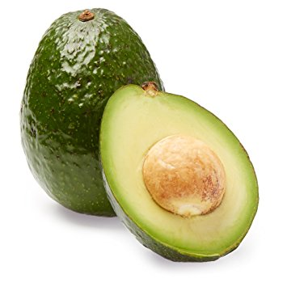
Round 3
Question 6
Name this fruit grown in Kenya and South Africa?
© Seomra Ranga 2020 www.seomraranga.com

Slide 32
Round 2 Answers
© Seomra Ranga 2020 www.seomraranga.com

Slide 33
Round 2 Answers
Question 1
What is the group name for a family of giraffes: pack, herd, flock?
Herd
© Seomra Ranga 2020 www.seomraranga.com

Slide 34
Round 2 Answers
Question 2
In the rhyme, what animal is “terribly big and terribly fat”?
Elephant
© Seomra Ranga 2020 www.seomraranga.com

Slide 35
Round 2 Answers
Question 3
In what African country is the Masai Mara reserve?
Kenya
© Seomra Ranga 2020 www.seomraranga.com

Slide 36
Round 2 Answers
Question 4
What dance do Masai men perform for the women in their tribe?
Jumping Dance
© Seomra Ranga 2020 www.seomraranga.com

Slide 37
Round 2 Answers
Question 5
What is the largest lake in Africa?
Lake Victoria
© Seomra Ranga 2020 www.seomraranga.com

Slide 38
Round 2 Answers
Question 6
Name five of the eight fruits mentioned in “Handa’s Surprise”.
Orange, guava, banana, mango, pineapple, avocado, passion fruit, tangerine
© Seomra Ranga 2020 www.seomraranga.com

Slide 39
Round 4
© Seomra Ranga 2020 www.seomraranga.com

Slide 40
Round 4
Question 1
What is a baby lion called?
© Seomra Ranga 2020 www.seomraranga.com

Slide 41
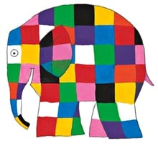
Round 4
Question 2
Name this elephant:
© Seomra Ranga 2020 www.seomraranga.com

Slide 42
Round 4
Question 3
What is the group name for a family of hyenas: herd, pride, pack, clan?
© Seomra Ranga 2020 www.seomraranga.com

Slide 43
Round 4
Question 4
What is the fastest land animal found in Africa?
© Seomra Ranga 2020 www.seomraranga.com

Slide 44
Round 4
Question 5
What do you call a trip to see wild animals in Africa?
© Seomra Ranga 2020 www.seomraranga.com

Slide 45
Round 4
Question 6
What is the largest country in Africa: Algeria, Angola, Uganda?
© Seomra Ranga 2020 www.seomraranga.com

Slide 46
Round 3 Answers
© Seomra Ranga 2020 www.seomraranga.com

Slide 47
Round 3 Answers
Question 1
What is the group name for a family of lions: swarm, herd, pride?
Pride
© Seomra Ranga 2020 www.seomraranga.com

Slide 48
Round 3 Answers
Question 2
Which African animal is famous for its laugh?
Hyena
© Seomra Ranga 2020 www.seomraranga.com

Slide 49
Round 3 Answers
Question 3
What is the name of the line that runs through the centre of Africa?
Equator
© Seomra Ranga 2020 www.seomraranga.com

Slide 50
Round 3 Answers
Question 4
What is the Masai tribe’s favourite colour: blue, red, green?
Red
© Seomra Ranga 2020 www.seomraranga.com

Slide 51
Round 3 Answers
Question 5
What is the largest island off Africa?
Madagascar
© Seomra Ranga 2020 www.seomraranga.com

Slide 52
Round 3 Answers
Question 6
Name this fruit grown in Kenya and South Africa?
Avocado
© Seomra Ranga 2020 www.seomraranga.com

Slide 53
Round 5
© Seomra Ranga 2020 www.seomraranga.com

Slide 54
Round 5
Question 1
Is Africa a country or a continent?
© Seomra Ranga 2020 www.seomraranga.com

Slide 55
Round 5
Question 2
Which animal in “Handa’s Surprise” took the passion fruit?
© Seomra Ranga 2020 www.seomraranga.com

Slide 56
Round 5
Question 3
What is the tallest land animal in Africa?
© Seomra Ranga 2020 www.seomraranga.com

Slide 57
Round 5
Question 4
Name two countries in Africa that begin with the letter Z.
© Seomra Ranga 2020 www.seomraranga.com

Slide 58
Round 5
Question 5
What is the name of the largest desert in the world, found in Africa?
© Seomra Ranga 2020 www.seomraranga.com

Slide 59
Round 5
Question 6
What is the highest mountain in Kenya?
© Seomra Ranga 2020 www.seomraranga.com

Slide 60
Round 4 Answers
© Seomra Ranga 2020 www.seomraranga.com

Slide 61
Round 4 Answers
Question 1
What is a baby lion called?
Cub
© Seomra Ranga 2020 www.seomraranga.com

Slide 62
Round 4 Answers
Question 2
Name this elephant:
Elmer
© Seomra Ranga 2020 www.seomraranga.com

Slide 63
Round 4 Answers
Question 3
What is the group name for a family of hyenas: herd, pride, pack, clan?
Clan
© Seomra Ranga 2020 www.seomraranga.com

Slide 64
Round 4 Answers
Question 4
What is the fastest land animal found in Africa?
Cheetah
© Seomra Ranga 2020 www.seomraranga.com

Slide 65
Round 4 Answers
Question 5
What do you call a trip to see wild animals in Africa?
Safari
© Seomra Ranga 2020 www.seomraranga.com

Slide 66
Round 4 Answers
Question 6
What is the largest country in Africa: Algeria, Angola, Uganda?
Algeria
© Seomra Ranga 2020 www.seomraranga.com

Slide 67
Round 6
© Seomra Ranga 2020 www.seomraranga.com

Slide 68
Round 6
Question 1
How many recognised countries are there in Africa: 26, 49, 54, 65?
© Seomra Ranga 2020 www.seomraranga.com

Slide 69
Round 6
Question 2
What is the hair around a lion’s head called?
© Seomra Ranga 2020 www.seomraranga.com

Slide 70
Round 6
Question 3
What is the largest land mammal in Africa?
© Seomra Ranga 2020 www.seomraranga.com

Slide 71
Round 6
Question 4
What is the family name for a group of meerkats?
© Seomra Ranga 2020 www.seomraranga.com

Slide 72
Round 6
Question 5
Which African animal is a member of the pig family?
© Seomra Ranga 2020 www.seomraranga.com

Slide 73
Round 6
Question 6
What is the name of the longest river in Africa?
© Seomra Ranga 2020 www.seomraranga.com

Slide 74
Round 5 Answers
© Seomra Ranga 2020 www.seomraranga.com

Slide 75
Round 5 Answers
Question 1
Is Africa a country or a continent?
Continent
© Seomra Ranga 2020 www.seomraranga.com

Slide 76
Round 5 Answers
Question 2
Which animal in “Handa’s Surprise” took the passion fruit?
Parrot
© Seomra Ranga 2020 www.seomraranga.com

Slide 77
Round 5 Answers
Question 3
What is the tallest land animal in Africa?
Giraffe
© Seomra Ranga 2020 www.seomraranga.com

Slide 78
Round 5 Answers
Question 4
Name two countries in Africa that begin with the letter Z.
Zambia & Zimbabwe
© Seomra Ranga 2020 www.seomraranga.com

Slide 79
Round 5 Answers
Question 5
What is the name of the largest desert in the world, found in Africa?
Sahara
© Seomra Ranga 2020 www.seomraranga.com

Slide 80
Round 5 Answers
Question 6
What is the highest mountain in Kenya?
Mount Kenya
© Seomra Ranga 2020 www.seomraranga.com

Slide 81
Round 6 Answers
© Seomra Ranga 2020 www.seomraranga.com

Slide 82
Round 6 Answers
Question 1
How many recognised countries are there in Africa: 26, 49, 54, 65?
54
© Seomra Ranga 2020 www.seomraranga.com

Slide 83
Round 6 Answers
Question 2
What is the hair around a lion’s head called?
Mane
© Seomra Ranga 2020 www.seomraranga.com

Slide 84
Round 6 Answers
Question 3
What is the largest land mammal in Africa?
African Elephant
© Seomra Ranga 2020 www.seomraranga.com

Slide 85
Round 6 Answers
Question 4
What is the family name for a group of meerkats?
Mob/Gang
© Seomra Ranga 2020 www.seomraranga.com

Slide 86
Round 6 Answers
Question 5
Which African animal is a member of the pig family?
Warthog
© Seomra Ranga 2020 www.seomraranga.com

Slide 87
Round 6 Answers
Question 6
What is the name of the longest river in Africa?
The Nile
© Seomra Ranga 2020 www.seomraranga.com

Slide 88
Tie-Break Round
© Seomra Ranga 2020 www.seomraranga.com

Slide 89
Tie-Break Round
Question 1
True or false: Africa is the largest of the continents?
© Seomra Ranga 2020 www.seomraranga.com

Slide 90
Tie-Break Round
Question 2
Cheetah, lion, jaguar, leopard are all members of what family?
© Seomra Ranga 2020 www.seomraranga.com

Slide 91
Tie-Break Round
Question 3
What currency is used in Kenya?
© Seomra Ranga 2020 www.seomraranga.com

Slide 92
Tie-Break Round
Question 4
True or false: along with lions, giraffes and elephants, Africa is also home to penguins?
© Seomra Ranga 2020 www.seomraranga.com

Slide 93
Tie-Break Round
Question 5
Zaire, Zambezi and Limpopo are all _____ in Africa: mountains, lakes, rivers?
© Seomra Ranga 2020 www.seomraranga.com

Slide 94
Tie-Break Round
Question 6
What is the most common language spoken in all of Africa: English, Swahili, Yoruba, Zulu?
© Seomra Ranga 2020 www.seomraranga.com

Slide 95
Tie-Break Answers
© Seomra Ranga 2020 www.seomraranga.com

Slide 96
Tie-Break Round
Question 1
True or false: Africa is the largest of the continents?
False (Asia is the largest)
© Seomra Ranga 2020 www.seomraranga.com

Slide 97
Tie-Break Round
Question 2
Cheetah, lion, jaguar, leopard are all members of what family?
Cat
© Seomra Ranga 2020 www.seomraranga.com

Slide 98
Tie-Break Round
Question 3
What currency is used in Kenya?
Kenyan Shilling
© Seomra Ranga 2020 www.seomraranga.com

Slide 99
Tie-Break Round
Question 4
True or false: along with lions, giraffes and elephants, Africa is also home to penguins?
True
© Seomra Ranga 2020 www.seomraranga.com

Slide 100
Tie-Break Round
Question 5
Zaire, Zambezi and Limpopo are all _____ in Africa: mountains, lakes, rivers?
Rivers
© Seomra Ranga 2020 www.seomraranga.com

Slide 101
Tie-Break Round
Question 6
What is the most common language spoken in all of Africa: English, Swahili, Yoruba, Zulu?
Swahili
© Seomra Ranga 2020 www.seomraranga.com

Slide 102
Hope you all enjoyed the quiz!
© Seomra Ranga 2020 www.seomraranga.com

Slide 103
Acknowledgements:
Background Template from : prezentr.com
Thanks to my colleagues for help in compiling questions for this quiz
© Seomra Ranga 2020 www.seomraranga.com

