Slide 1
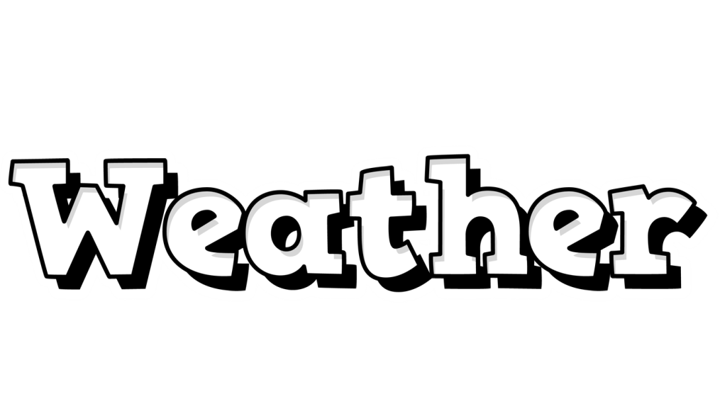
© Seomra Ranga 2022 www.seomraranga.com

Slide 2
In the Beginning:
The art of weather forecasting began with the early civilisations using recurring astronomical and meteorological events to help them to monitor changes in the weather and make predictions of future weather patterns.
© Seomra Ranga 2022 www.seomraranga.com

Slide 3
Later on:
Throughout the centuries, forecasts about weather patterns continued to be based on weather lore and personal observations of the weather. However, such predictions proved to be inadequate and sometimes inaccurate.
© Seomra Ranga 2022 www.seomraranga.com

Slide 4
Later still:
By the middle ages, it was clearly understood that further knowledge was necessary in order to make proper predictions about the weather. Instruments were needed in order to measure aspects of the weather.
© Seomra Ranga 2022 www.seomraranga.com

Slide 5
First Instruments:
In the mid-15th century, the first form of a hygrometer was invented to measure humidity in the air. Around 1592, the first thermometer was invented to measure air temperature. In 1643, the first barometer was invented to measure atmospheric pressure.
© Seomra Ranga 2022 www.seomraranga.com

Slide 6
The Telegraph:
The invention of the telegraph in the mid-19th century allowed data which was compiled from weather observations to be transmitted to centralised observers and compilers. To help with this, weather observation stations were established in many locations.
© Seomra Ranga 2022 www.seomraranga.com

Slide 7
Weather Maps:
Collecting and interpreting this data allowed for the creation of the first weather maps.
© Seomra Ranga 2022 www.seomraranga.com

Slide 8
The Radiosonde:
The art of weather forecasting took another leap forward with the invention of the radiosonde in the 1920s. This was a battery-powered instrument carried into the air by a weather balloon to measure aspects of the weather and to transmit the results by radio to a ground receiver.
© Seomra Ranga 2022 www.seomraranga.com

Slide 9
The Radiosonde:
The data collected by the radiosonde could then be processed and used to create more detailed weather maps. Today, radiosondes are launched every 12 hours from hundreds of weather stations all around the world.
© Seomra Ranga 2022 www.seomraranga.com

Slide 10
National Meteorological Services:
Towards the end of the 19th century, national meteorological services began to be established. The United States service was set up in 1871, followed soon by services in Japan, India and Brazil. In 1880, the International Meteorological Organisation (IMO) was set up.
© Seomra Ranga 2022 www.seomraranga.com

Slide 11
Ireland’s Meteorological Service:
The first ‘real time’ weather observation was transmitted from Valentia Island in Co. Kerry on the 8th October 1860. It was not until 1936 that the Irish Meteorological Service was established to provide accurate weather information for transatlantic aviation.
© Seomra Ranga 2022 www.seomraranga.com

Slide 12
Ireland’s Meteorological Service:
In 1948 Ireland’s Meteorological Service assumed responsibility for the weather forecasts broadcast by Raidió Éireann. In 1952 it began to supply forecasts to the daily newspapers. In 1962, it began live broadcasts on Teilifís Éireann. In 1979 its headquarters were moved to Glasnevin, Dublin.
© Seomra Ranga 2022 www.seomraranga.com

Slide 13
Ireland’s Meteorological Service:
In 1990, a high resolution weather radar system was installed at Dublin Airport and another one was installed in Shannon Airport in 1996. Also in 1996, the Meteorological Service changed its name to Met Éireann. Met Éireann launched its website in 2001.
© Seomra Ranga 2022 www.seomraranga.com

Slide 14
Ireland’s Meteorological Service:
Today, Met Éireann provides weather information to the state. It monitors, analyses and predicts Ireland’s weather and climate and provides a range of high quality meteorological and related information to the public and others eg. farmers and the fishing and aviation industries.
© Seomra Ranga 2022 www.seomraranga.com

Slide 15
Ireland’s Meteorological Service:
Met Éireann now provides weather forecasts for newspapers, television, radio, internet and mobile application platforms.
www.met.ie
© Seomra Ranga 2022 www.seomraranga.com

Slide 16
Resources used in this file from:
https://www.teacherspayteachers.com/Store/Krista-Wallden-Creative-Clips
https://www.teacherspayteachers.com/Store/Hello-Literacy
https://www.textgiraffe.com/
https://depositphotos.com/
© Seomra Ranga 2022 www.seomraranga.com

