Slide 1
© Seomra Ranga 2023 www.seomraranga.com

Slide 2
Fáilte go dtí Tráth na gCeist 2023
Tá súil againn go mbainfidh sibh taitneamh as
© Seomra Ranga 2023 www.seomraranga.com

Slide 3
Scríobh uimhir d’fhoireann ar gach bileog freagartha
Scríobh uimhir gach babhta 1-8 ar gach bileog freagartha
Déan iarracht na freagraí a scríobh as Gaeilge
Ná bí buartha faoi na litriú – déan do dhícheall
© Seomra Ranga 2023 www.seomraranga.com

Slide 4
Sula scríobhann sibh síos an freagra, faigh amach go n-aontaíonn gach duine faoi
Muna bhfuil an freagra ar eolas agaibh, déanaigí tomhais
Ná screadaigí amach na freagraí – bígí ciúin
Bainigí taitneamh as!
© Seomra Ranga 2023 www.seomraranga.com

Slide 5
Bígí réidh
anois …..
© Seomra Ranga 2023 www.seomraranga.com

Slide 6
Go n-éirí an t-ádh libh
© Seomra Ranga 2023 www.seomraranga.com

Slide 7
© Seomra Ranga 2023 www.seomraranga.com

Slide 8
Ceist 1:
Ainmnigh an t-ainmhí seo:
© Seomra Ranga 2023 www.seomraranga.com

Slide 9
Ceist 2:
Cé mhéad liathróid dubh atá ar bhord snúcair ag tús an chluiche?
© Seomra Ranga 2023 www.seomraranga.com

Slide 10
Ceist 3:
Scríobh an uimhir seo: mile, ocht gcéad, daichead a seacht.
© Seomra Ranga 2023 www.seomraranga.com

Slide 11
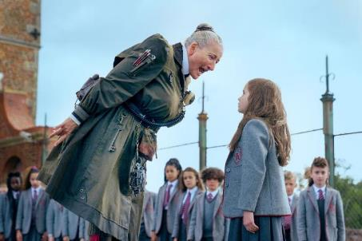
Ceist 4:
Ainmnigh an scannán seo:
© Seomra Ranga 2023 www.seomraranga.com

Slide 12
Ceist 5:
Ainmnigh tír amháin inár tharla crith talún (earthquake) ar Feabhra 6, 2023.
© Seomra Ranga 2023 www.seomraranga.com

Slide 13
Ceist 6:
Cé mhéad contae atá i gCúige Laighean?
© Seomra Ranga 2023 www.seomraranga.com

Slide 14
© Seomra Ranga 2023 www.seomraranga.com

Slide 15
Duine ag ordú iasc sa Ghaeltacht:
Cod - Cad?
Cod - Cad?
Cod - Cad?
Cod - Cad?
COD – CAD?
© Seomra Ranga 2023 www.seomraranga.com

Slide 16
© Seomra Ranga 2023 www.seomraranga.com

Slide 17
Ceist 1:
Cén chuid den chorp ar a gcaitear buataisí?
© Seomra Ranga 2023 www.seomraranga.com

Slide 18
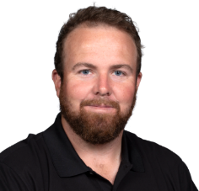
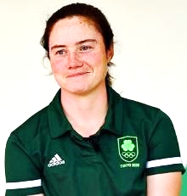
Ceist 2:
Cén Spórt a imríonn Shane Lowry agus Leona Maguire?
© Seomra Ranga 2023 www.seomraranga.com

Slide 19
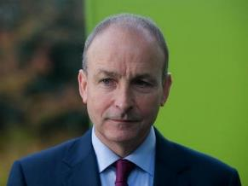
Ceist 3:
Fíor nó bréagach: Is é Micheál Ó Máirtín Taoiseach na hÉireann?
© Seomra Ranga 2023 www.seomraranga.com

Slide 20
Ceist 4:
Cén sort aimsire é seo?
© Seomra Ranga 2023 www.seomraranga.com

Slide 21
Ceist 5:
Tá mé i mo chónaí sa Róimh. Labhraím Iodáilis. Cén tír ina bhfuil mé?
© Seomra Ranga 2023 www.seomraranga.com

Slide 22
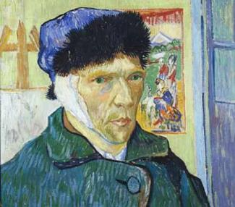
Ceist 6:
Ainmnigh an ealaíontóir cáiliúil seo:
© Seomra Ranga 2023 www.seomraranga.com

Slide 23
© Seomra Ranga 2023 www.seomraranga.com

Slide 24
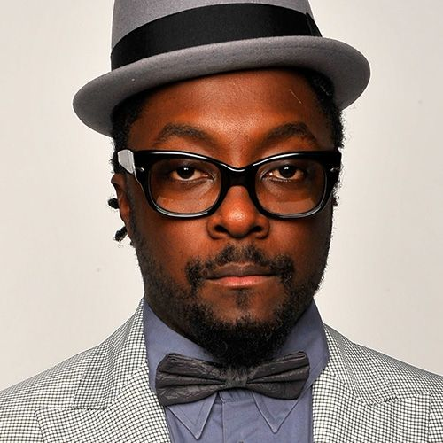
Bhfuil.I.Am!!
© Seomra Ranga 2023 www.seomraranga.com

Slide 25
© Seomra Ranga 2023 www.seomraranga.com

Slide 26
Ceist 1:
Ainmnigh an t-ainmhí seo:
Míorchat
© Seomra Ranga 2023 www.seomraranga.com

Slide 27
Ceist 2:
Cé mhéad liathróid dubh atá ar bhord snúcair ag tús an chluiche?
Liathróid Amháin (1)
© Seomra Ranga 2023 www.seomraranga.com

Slide 28
Ceist 3:
Scríobh an uimhir seo: mile, ocht gcéad, daichead a seacht.
1,847
© Seomra Ranga 2023 www.seomraranga.com

Slide 29
Ceist 4:
Ainmnigh an scannán seo:
Matilda
© Seomra Ranga 2023 www.seomraranga.com

Slide 30
Ceist 5:
Ainmnigh tír amháin inár tharla crith talún (earthquake) ar Feabhra 6, 2023.
An Tuirc/An tSiria
© Seomra Ranga 2023 www.seomraranga.com

Slide 31
Ceist 6:
Cé mhéad contae atá i gCúige Laighean?
12
© Seomra Ranga 2023 www.seomraranga.com

Slide 32
© Seomra Ranga 2023 www.seomraranga.com

Slide 33
Cad a bhí ag an bhfrog don lón?
Burgar agus diet croak!!
© Seomra Ranga 2023 www.seomraranga.com

Slide 34
© Seomra Ranga 2023 www.seomraranga.com

Slide 35
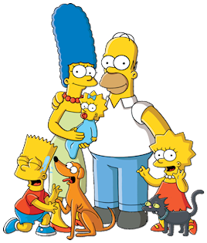
Ceist 1:
Cén t-ainm atá ar an bpáiste is óige i gclann Simpsons?
© Seomra Ranga 2023 www.seomraranga.com

Slide 36
Ceist 2:
Cé acu seo atá as ionad: ceapaire, cáis, cáca, sceallóga, peann, ispíní?
© Seomra Ranga 2023 www.seomraranga.com

Slide 37
Ceist 3:
Cé mhéad taobh atá ar heicseagán?
© Seomra Ranga 2023 www.seomraranga.com

Slide 38
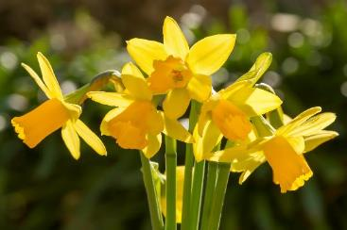
Ceist 4:
Cén sort bláthanna iad seo: plúiríní sneachta, tiúilipí nó lusanna an chromchinn?
© Seomra Ranga 2023 www.seomraranga.com

Slide 39
Ceist 5:
Cén dathanna atá ar bhrat na Spáinne?
© Seomra Ranga 2023 www.seomraranga.com

Slide 40
Ceist 6:
Cé hé Rí an Ríocht Aontaithe (UK)?
© Seomra Ranga 2023 www.seomraranga.com

Slide 41
© Seomra Ranga 2023 www.seomraranga.com

Slide 42
Cá bhfuil tú ábalta a fhoghlaim conas a dhéantar uachtar reoite?
Scoil Sundae!
© Seomra Ranga 2023 www.seomraranga.com

Slide 43
© Seomra Ranga 2023 www.seomraranga.com

Slide 44
Ceist 1:
Cén chuid den chorp ar a gcaitear buataisí?
Cosa
© Seomra Ranga 2023 www.seomraranga.com

Slide 45
Ceist 2:
Cén Spórt a imríonn Shane Lowry agus Leona Maguire?
Galf
© Seomra Ranga 2023 www.seomraranga.com

Slide 46
Ceist 3:
Fíor nó bréagach: Is é Micheál Ó Máirtín Taoiseach na hÉireann?
Bréagach
© Seomra Ranga 2023 www.seomraranga.com

Slide 47
Ceist 4:
Cén sort aimsire é seo?
Scamallach
© Seomra Ranga 2023 www.seomraranga.com

Slide 48
Ceist 5:
Tá mé i mo chónaí sa Róimh. Labhraím Iodáilis. Cén tír ina bhfuil mé?
An Iodáil
© Seomra Ranga 2023 www.seomraranga.com

Slide 49
Ceist 6:
Ainmnigh an ealaíontóir cáiliúil seo:
Vincent Van Gogh
© Seomra Ranga 2023 www.seomraranga.com

Slide 50
© Seomra Ranga 2023 www.seomraranga.com

Slide 51
Múinteoir: Ar chabhraigh d’athair duit do chuid obair bhaile a dhéanamh?
Dalta: Níor chabhraigh, rinne sé é go léir leis féin!
© Seomra Ranga 2023 www.seomraranga.com

Slide 52
© Seomra Ranga 2023 www.seomraranga.com

Slide 53
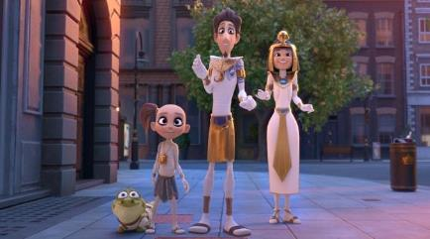
Ceist 1:
Ainmnigh an scannán seo:
© Seomra Ranga 2023 www.seomraranga.com

Slide 54
Ceist 2:
Cén sort bia iad seo: naan, pitta agus ciabatta?
© Seomra Ranga 2023 www.seomraranga.com

Slide 55
Ceist 3:
Cé a chanann an t-amhrán “As It Was”?
© Seomra Ranga 2023 www.seomraranga.com

Slide 56
Ceist 4:
Cad é seo:
© Seomra Ranga 2023 www.seomraranga.com

Slide 57
Ceist 5:
Críochnaigh an seanfhocal: ___ maith, leath na hoibre.
© Seomra Ranga 2023 www.seomraranga.com

Slide 58
Ceist 6:
Cad í an abhainn is faide ar domhain?
© Seomra Ranga 2023 www.seomraranga.com

Slide 59
© Seomra Ranga 2023 www.seomraranga.com

Slide 60
Bhí bosca bananas fágtha ar an mbord.
“Ceann don ‘Fyffe’ a day”, a dúirt mé!
© Seomra Ranga 2023 www.seomraranga.com

Slide 61
© Seomra Ranga 2023 www.seomraranga.com

Slide 62
Ceist 1:
Cén t-ainm atá ar an bpáiste is óige i gclann Simpsons?
Maggie
© Seomra Ranga 2023 www.seomraranga.com

Slide 63
Ceist 2:
Cé acu seo atá as ionad: ceapaire, cáis, cáca, sceallóga, peann, ispíní?
Peann
© Seomra Ranga 2023 www.seomraranga.com

Slide 64
Ceist 3:
Cé mhéad taobh atá ar heicseagán?
Sé (6)
© Seomra Ranga 2023 www.seomraranga.com

Slide 65
Ceist 4:
Cén sort bláthanna iad seo: plúiríní sneachta, tiúilipí nó lusanna an chromchinn?
Lusanna an Chromchinn
© Seomra Ranga 2023 www.seomraranga.com

Slide 66
Ceist 5:
Cén dathanna atá ar bhrat na Spáinne?
Dearg agus Buí
© Seomra Ranga 2023 www.seomraranga.com

Slide 67
Ceist 6:
Cé hé Rí an Ríocht Aontaithe (UK)?
An Rí Séarlais III (Charles)
© Seomra Ranga 2023 www.seomraranga.com

Slide 68
© Seomra Ranga 2023 www.seomraranga.com

Slide 69
Cén Gaeilge atá ar “igloo”?
Choc Ice (Teach Ice)!
© Seomra Ranga 2023 www.seomraranga.com

Slide 70
© Seomra Ranga 2023 www.seomraranga.com

Slide 71
Ceist 1:
Cén clár teilifíse ina bhfuil Jennifer Zamparelli agus Doireann Garrihy mar láithreoirí air?
© Seomra Ranga 2023 www.seomraranga.com

Slide 72
Ceist 2:
Cén t-ainm atá ar thriantán mar seo:
© Seomra Ranga 2023 www.seomraranga.com

Slide 73
Ceist 3:
Cén t-ainm atá ar changarú óg?
© Seomra Ranga 2023 www.seomraranga.com

Slide 74
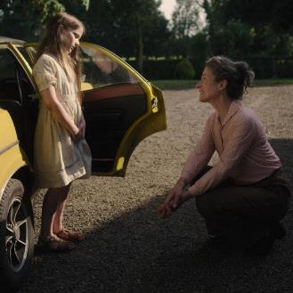
Ceist 4:
Ainmnigh an scannán seo:
© Seomra Ranga 2023 www.seomraranga.com

Slide 75
Ceist 5:
Cé a scríobh na leabhair “Fing” agus “Spaceboy”?
© Seomra Ranga 2023 www.seomraranga.com

Slide 76
Ceist 6:
Cé mhéad imreoir atá ar fhoireann cispheile?
© Seomra Ranga 2023 www.seomraranga.com

Slide 77
© Seomra Ranga 2023 www.seomraranga.com

Slide 78
Ainmnigh an duine in oifig na scoile.
Ann Rooney (An Rúnaí)!
© Seomra Ranga 2023 www.seomraranga.com

Slide 79
© Seomra Ranga 2023 www.seomraranga.com

Slide 80
Ceist 1:
Ainmnigh an scannán seo:
Mummies
© Seomra Ranga 2023 www.seomraranga.com

Slide 81
Ceist 2:
Cén sort bia iad seo: naan, pitta agus ciabatta?
Arán
© Seomra Ranga 2023 www.seomraranga.com

Slide 82
Ceist 3:
Cé a chanann an t-amhrán “As It Was”?
Harry Styles
© Seomra Ranga 2023 www.seomraranga.com

Slide 83
Ceist 4:
Cad é seo:
Fáinne
© Seomra Ranga 2023 www.seomraranga.com

Slide 84
Ceist 5:
Críochnaigh an seanfhocal: ___ maith, leath na hoibre.
Tús
© Seomra Ranga 2023 www.seomraranga.com

Slide 85
Ceist 6:
Cad í an abhainn is faide ar domhain?
An Níl (Nile)
© Seomra Ranga 2023 www.seomraranga.com

Slide 86
© Seomra Ranga 2023 www.seomraranga.com

Slide 87
Cén t-ainm atá ar chreatlach gaelach
Jimmy Mc Cracken
(D’imigh mo chraiceann)!
© Seomra Ranga 2023 www.seomraranga.com

Slide 88
© Seomra Ranga 2023 www.seomraranga.com

Slide 89
Ceist 1:
Cad í príomhchathair na Gréige (Greece)?
© Seomra Ranga 2023 www.seomraranga.com

Slide 90
Ceist 2:
Liom, leat, leis, léi, ___, libh, leo.
© Seomra Ranga 2023 www.seomraranga.com

Slide 91
Ceist 3:
Cén sort béar a itheann bambú, de ghnáth?
© Seomra Ranga 2023 www.seomraranga.com

Slide 92
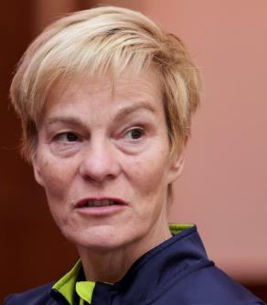
Ceist 4:
Cé hí bainisteoir foireann sacar na hÉireann?
© Seomra Ranga 2023 www.seomraranga.com

Slide 93
Ceist 5:
Fíor nó bréagach – tá cósta ag Co. Ros Comáin?
© Seomra Ranga 2023 www.seomraranga.com

Slide 94
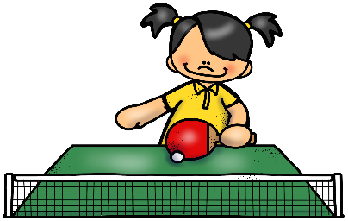
Ceist 6:
Cén spórt atá an cailín ag imirt?
© Seomra Ranga 2023 www.seomraranga.com

Slide 95
© Seomra Ranga 2023 www.seomraranga.com

Slide 96
Cnag cnag
Cé atá ann?
Neilus
Cén Neilus
Níl a fhios agam!
© Seomra Ranga 2023 www.seomraranga.com

Slide 97
© Seomra Ranga 2023 www.seomraranga.com

Slide 98
Ceist 1:
Cén clár teilifíse ina bhfuil Jennifer Zamparelli agus Doireann Garrihy mar láithreoirí air?
Dancing With the Stars
© Seomra Ranga 2023 www.seomraranga.com

Slide 99
Ceist 2:
Cén t-ainm atá ar thriantán mar seo:
Isoceles
© Seomra Ranga 2023 www.seomraranga.com

Slide 100
Ceist 3:
Cén t-ainm atá ar changarú óg?
Joey
© Seomra Ranga 2023 www.seomraranga.com

Slide 101
Ceist 4:
Ainmnigh an scannán seo:
An Cailín Ciúin
© Seomra Ranga 2023 www.seomraranga.com

Slide 102
Ceist 5:
Cé a scríobh na leabhair “Fing” agus “Spaceboy”?
David Walliams
© Seomra Ranga 2023 www.seomraranga.com

Slide 103
Ceist 6:
Cé mhéad imreoir atá ar fhoireann cispheile?
Cúigear (5)
© Seomra Ranga 2023 www.seomraranga.com

Slide 104
© Seomra Ranga 2023 www.seomraranga.com

Slide 105
Cén fath go mbíonn bogha báistí tinn go minic?
Mar tá sí “ill-daite”!!
© Seomra Ranga 2023 www.seomraranga.com

Slide 106
© Seomra Ranga 2023 www.seomraranga.com

Slide 107
Ceist 1:
Nuair a meascann tú an dath buí agus an dath gorm, cén dath a fhaigheann tú?
© Seomra Ranga 2023 www.seomraranga.com

Slide 108
Ceist 2:
Cé a chanann an t-amhrán “Flowers”?
© Seomra Ranga 2023 www.seomraranga.com

Slide 109
Ceist 3:
Cé mhéad lá atá i mí Feabhra i mbliain bhisigh?
© Seomra Ranga 2023 www.seomraranga.com

Slide 110
Ceist 4:
Ainmnigh an tír seo:
© Seomra Ranga 2023 www.seomraranga.com

Slide 111
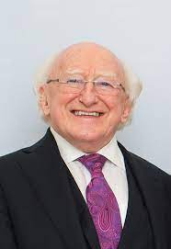
Ceist 5:
Cé hé Uachtarán na hÉireann?
© Seomra Ranga 2023 www.seomraranga.com

Slide 112
Ceist 6:
Cén luach atá ar an uimhir Rómhánach seo: MDCCXXIV
© Seomra Ranga 2023 www.seomraranga.com

Slide 113
© Seomra Ranga 2023 www.seomraranga.com

Slide 114
Cén fath go raibh an bó caillte?
D’imigh sé amúúúúú!!
© Seomra Ranga 2023 www.seomraranga.com

Slide 115
© Seomra Ranga 2023 www.seomraranga.com

Slide 116
Ceist 1:
Cad í príomhchathair na Gréige (Greece)?
An Aithin (Athens)
© Seomra Ranga 2023 www.seomraranga.com

Slide 117
Ceist 2:
Liom, leat, leis, léi, ___, libh, leo.
Linn
© Seomra Ranga 2023 www.seomraranga.com

Slide 118
Ceist 3:
Cén sort béar a itheann bambú, de ghnáth?
Panda
© Seomra Ranga 2023 www.seomraranga.com

Slide 119
Ceist 4:
Cé hí bainisteoir foireann sacar na hÉireann?
Vera Pauw
© Seomra Ranga 2023 www.seomraranga.com

Slide 120
Ceist 5:
Fíor nó bréagach – tá cósta ag Co. Ros Comáin?
Bréagach
© Seomra Ranga 2023 www.seomraranga.com

Slide 121
Ceist 6:
Cén spórt atá an cailín ag imirt?
Leadóg Bhoird
© Seomra Ranga 2023 www.seomraranga.com

Slide 122
© Seomra Ranga 2023 www.seomraranga.com

Slide 123
Céard atá buí is dubh, is buí is dubh, is buí is dubh?
Beach ag titim síos an staighre!
© Seomra Ranga 2023 www.seomraranga.com

Slide 124
© Seomra Ranga 2023 www.seomraranga.com

Slide 125
Ceist 1:
Cén mhí ina mbíonn Lá Fhéile Bríde?
© Seomra Ranga 2023 www.seomraranga.com

Slide 126
Ceist 2:
Cén contae in Éirinn ina bhfuil Caisleán an Bharraigh?
© Seomra Ranga 2023 www.seomraranga.com

Slide 127
Ceist 3:
Cén seomra sa teach ina fheiceann tú cithfholcadán?
© Seomra Ranga 2023 www.seomraranga.com

Slide 128
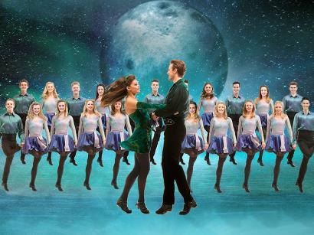
Ceist 4:
Ainmnigh an damhsa seo:
© Seomra Ranga 2023 www.seomraranga.com

Slide 129
Ceist 5:
Cén tír a bhuaigh Corn an Domhain 2022 i gCatar?
© Seomra Ranga 2023 www.seomraranga.com

Slide 130
Ceist 6:
Fágann an bus an stáisiún ag 7:45am. Stopann sé 5 uair, le 12 nóiméad idir gach stop. Cén t-am é nuair a shroicheann sé an cúigiú stop?
© Seomra Ranga 2023 www.seomraranga.com

Slide 131
© Seomra Ranga 2023 www.seomraranga.com

Slide 132
Cad a thugann tú ar shicín sa seomra ranga?
Ar Strae!!
© Seomra Ranga 2023 www.seomraranga.com

Slide 133
© Seomra Ranga 2023 www.seomraranga.com

Slide 134
Ceist 1:
Nuair a meascann tú an dath buí agus an dath gorm, cén dath a fhaigheann tú?
Glas
© Seomra Ranga 2023 www.seomraranga.com

Slide 135
Ceist 2:
Cé a chanann an t-amhrán “Flowers”?
Miley Cyrus
© Seomra Ranga 2023 www.seomraranga.com

Slide 136
Ceist 3:
Cé mhéad lá atá i mí Feabhra i mbliain bhisigh?
29
© Seomra Ranga 2023 www.seomraranga.com

Slide 137
Ceist 4:
Ainmnigh an tír seo:
An Astráil (Australia)
© Seomra Ranga 2023 www.seomraranga.com

Slide 138
Ceist 5:
Cé hé Uachtarán na hÉireann?
Micheál D. Ó hUiginn
© Seomra Ranga 2023 www.seomraranga.com

Slide 139
Ceist 6:
Cén luach atá ar an uimhir Rómhánach seo: MDCCXXIV
1724
© Seomra Ranga 2023 www.seomraranga.com

Slide 140
© Seomra Ranga 2023 www.seomraranga.com

Slide 141
Cad a thugann tú ar núdal bréige?
Impasta!!
© Seomra Ranga 2023 www.seomraranga.com

Slide 142
© Seomra Ranga 2023 www.seomraranga.com

Slide 143
Ceist 1:
Cén mhí ina mbíonn Lá Fhéile Bríde?
Feabhra
© Seomra Ranga 2023 www.seomraranga.com

Slide 144
Ceist 2:
Cén contae in Éirinn ina bhfuil Caisleán an Bharraigh?
Maigh Eo
© Seomra Ranga 2023 www.seomraranga.com

Slide 145
Ceist 3:
Cén seomra sa teach ina fheiceann tú cithfholcadán?
Seomra Folctha
© Seomra Ranga 2023 www.seomraranga.com

Slide 146
Ceist 4:
Ainmnigh an damhsa seo:
Riverdance
© Seomra Ranga 2023 www.seomraranga.com

Slide 147
Ceist 5:
Cén tír a bhuaigh Corn an Domhain 2022 i gCatar?
An Airgintín
© Seomra Ranga 2023 www.seomraranga.com

Slide 148
Ceist 6:
Fágann an bus an stáisiún ag 7:45am. Stopann sé 5 uair, le 12 nóiméad idir gach stop. Cén t-am é nuair a shroicheann sé an cúigiú stop?
8:45am
© Seomra Ranga 2023 www.seomraranga.com

Slide 149
© Seomra Ranga 2023 www.seomraranga.com

Slide 150
Cad a itheann cat don bhricfeasta?
Mice Criospaí
© Seomra Ranga 2023 www.seomraranga.com

Slide 151
© Seomra Ranga 2023 www.seomraranga.com

Slide 152
Ceist 1:
Cé mhéad poll do na méara atá ag feadóg stáin?
© Seomra Ranga 2023 www.seomraranga.com

Slide 153
Ceist 2:
Cathain atá Lá na nAmadán?
© Seomra Ranga 2023 www.seomraranga.com

Slide 154
Ceist 3:
Cén t-ainm atá ar an sióg sa scéal Peter Pan?
© Seomra Ranga 2023 www.seomraranga.com

Slide 155
Ceist 4:
Cén foireann sa Premiership a imríonn a gcluichí baile i Sráid Elland?
© Seomra Ranga 2023 www.seomraranga.com

Slide 156
Ceist 5:
Cé hé príomhcheannaire (Taoiseach) an UK?
© Seomra Ranga 2023 www.seomraranga.com

Slide 157
Ceist 6:
Madra – coileán
Caora – uan
Muc - ?
© Seomra Ranga 2023 www.seomraranga.com

Slide 158
© Seomra Ranga 2023 www.seomraranga.com

Slide 159
Cad a dúirt balla amháin don bhalla eile?
Feicfidh mé thú ag an gcúinne!!
© Seomra Ranga 2023 www.seomraranga.com

Slide 160
© Seomra Ranga 2023 www.seomraranga.com

Slide 161
Ceist 1:
Cé mhéad poll do na méara atá ag feadóg stáin?
Sé (6)
© Seomra Ranga 2023 www.seomraranga.com

Slide 162
Ceist 2:
Cathain atá Lá na nAmadán?
Aibreán 1
© Seomra Ranga 2023 www.seomraranga.com

Slide 163
Ceist 3:
Cén t-ainm atá ar an sióg sa scéal Peter Pan?
Tinkerbell
© Seomra Ranga 2023 www.seomraranga.com

Slide 164
Ceist 4:
Cén foireann sa Premiership a imríonn a gcluichí baile i Sráid Elland?
Leeds
© Seomra Ranga 2023 www.seomraranga.com

Slide 165
Ceist 5:
Cé hé príomhcheannaire (Taoiseach) an UK?
Rishi Sunak
© Seomra Ranga 2023 www.seomraranga.com

Slide 166
Ceist 6:
Madra – coileán
Caora – uan
Muc - ?
Banbh
© Seomra Ranga 2023 www.seomraranga.com

Slide 167
© Seomra Ranga 2023 www.seomraranga.com

Slide 168
Cad a dúirt an cat nuair a thit sé síos staighre?
Mí-owww!!
© Seomra Ranga 2023 www.seomraranga.com

Slide 169
Sin an Deireadh
© Seomra Ranga 2023 www.seomraranga.com

Slide 170
Tá súil againn gur bhain sibh taitneamh as na ceisteanna
© Seomra Ranga 2023 www.seomraranga.com

Slide 171
Slán agus beannacht
© Seomra Ranga 2023 www.seomraranga.com

Slide 172
For Your Information
Thank you for downloading this Seomra Ranga resource. We hope that you find it practical and useful in your classroom.
Please be aware of the following conditions before using this resource.
Please DO:
Print and copy this resource so that you can use it with your pupils.
Make this resource available to your pupils in a private enclosed online space eg. Google Classroom, Seesaw, Edublogs etc.
Tell others if you have found it useful.
Please DO NOT:
Copy or share this resource (in part or whole) with others who have not joined our website. By becoming a member for themselves, they will help the site develop into the future.
Make this resource available on your school website for anyone to download.
Share this resource with other teachers in online groups eg. Facebook Groups, WhatsApp Groups etc.
Kind regards, Seomra Ranga
© Seomra Ranga 2023 www.seomraranga.com

Slide 173
Úsáidtear íomhánna sa chomad seo ó:
https://www.teacherspayteachers.com/Store/Clipartino
https://www.teacherspayteachers.com/Store/Laine-Sutherland-Designs
https://www.teacherspayteachers.com/Store/Creating4-The-Classroom
https://www.teacherspayteachers.com/Store/Krista-Wallden-Creative-Clips
https://www.teacherspayteachers.com/Store/Whimsy-Clips
https://www.teacherspayteachers.com/Store/P4-Clips-Trioriginals
https://www.teacherspayteachers.com/Store/Educlips
https://www.teacherspayteachers.com/Store/Zip-a-dee-doo-dah-Designs
https://www.textgiraffe.com/
https://www.teacherspayteachers.com/Store/Photo-Clipz
https://depositphotos.com/
© Seomra Ranga 2023 www.seomraranga.com

